Slide 1
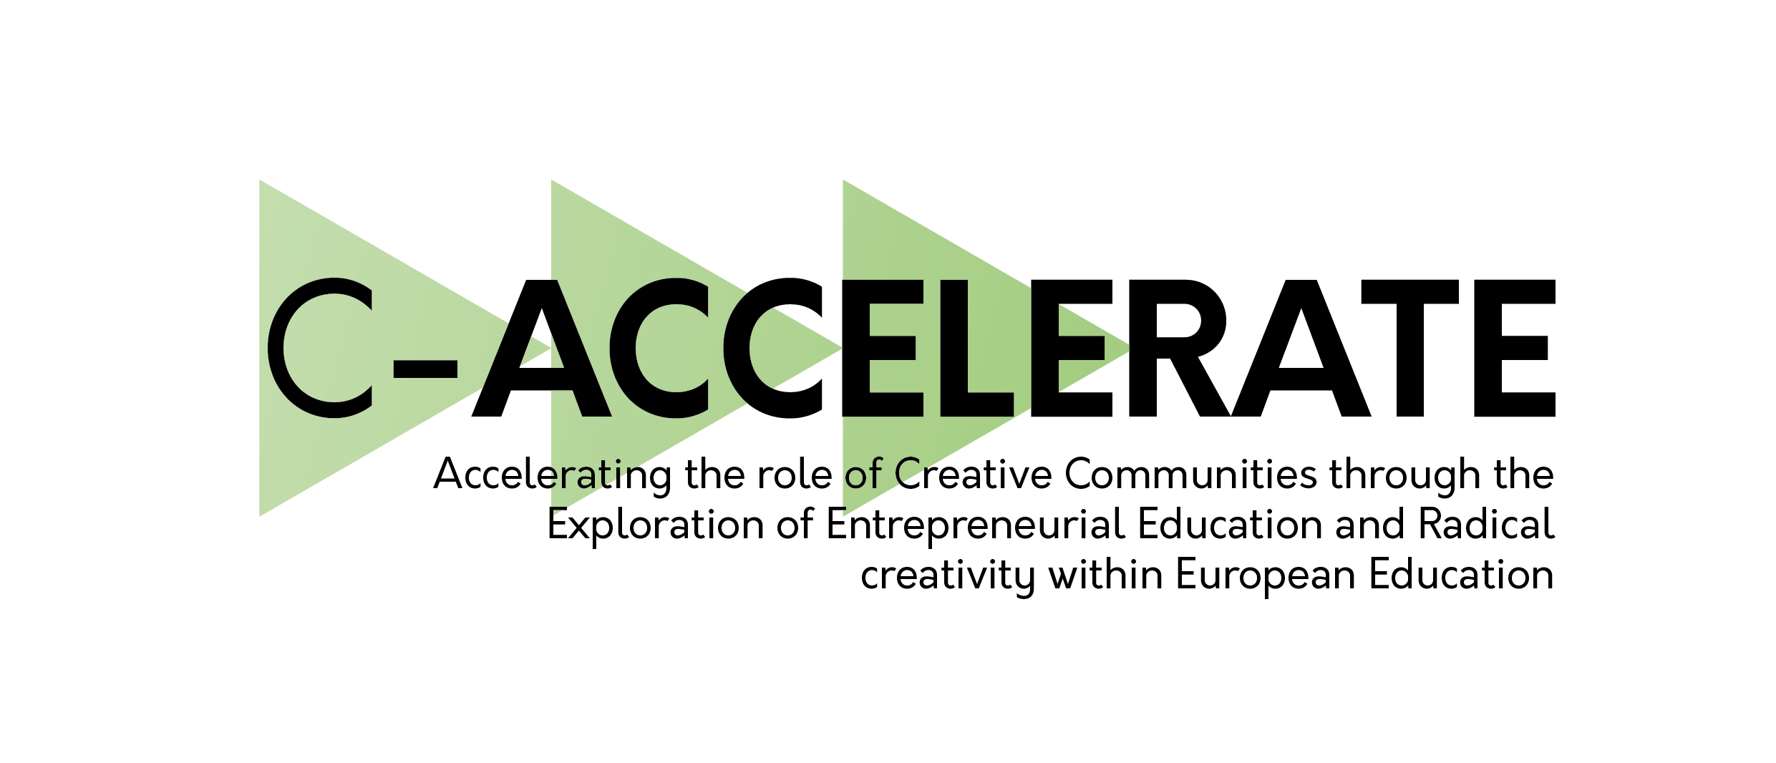
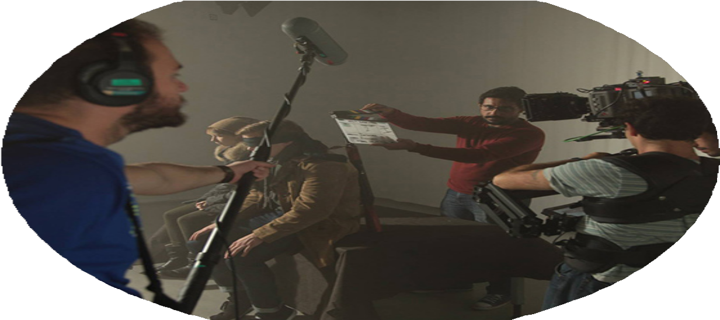
Accelerating the role of Creative Communities through the Exploration of Entrepreneurial Education and Radical creativity within European Education

Slide 2
C-Accelerate is a project aimed at increasing innovation and entrepreneurship in higher education for the arts and creative practices. The consortium consists of four European universities, including FilmEU, the European Universities Alliance for Film and Media Arts, and Aalto University. They aim to promote entrepreneurial education, innovation, and research in the multidisciplinary field of cultural and creative sectors and industries. C-Accelerate presents an ambitious innovation vision action plan that covers four dimensions, including entrepreneurial education, project development, support structures for creativity and knowledge transfer, and collaboration and institutional engagement.

Slide 3









Partners

Slide 4
DRAFT PROGRAMME HANDBOOK
IADT DELIVERABLE

Slide 5
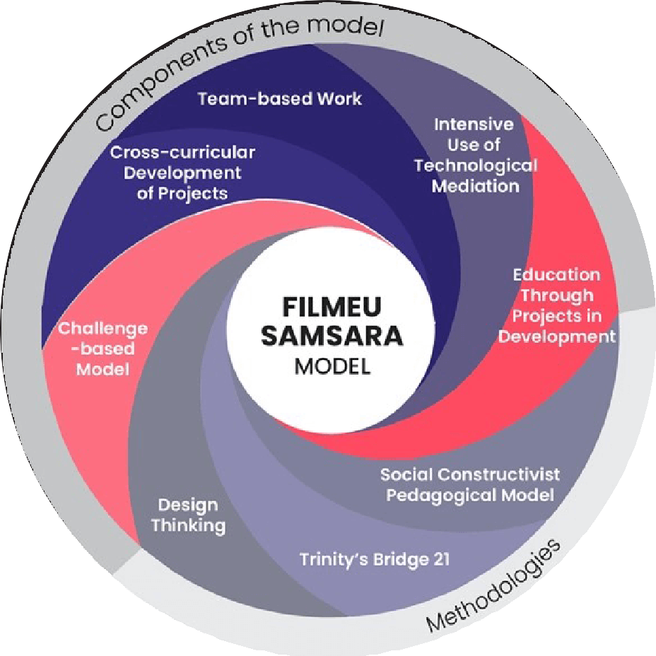
We are excited to introduce our new project, which builds upon the previously established Samsara
pedagogical framework initiated and implemented by FilmEU. Samsara is derived from the Sanskrit
word meaning “flowing on” or “passing through” and in Buddhism, it represents the endless cycle of birth, death, and rebirth.
At FilmEU, we chose this name to reflect our holistic and iterative approach to film and media arts education. Samsara proposes that artistic teaching, learning, research, and production are practice- based, collaborative endeavors that
engage ethically and actively with societal problems through the creative use and mediation of technology. The Pedagogical Guidelines of this project will be guided by the
learning theories, methodologies, and teaching approaches described in Samsara. We believe that
people learn best when they work together to create meaningful creative work on equal terms.

Slide 6
1. Learning Theories
2. Methodologies
3. Approaches
The Samsara pedagogical framework is based on three interconnected theories of learning: Constructivism, Social Constructivism, and Constructionism.
It proposes that knowledge is actively constructed through direct experience, interaction with others, using tools and technology in the creation of a meaningful artifact(s) that others will
see, use, or critique. These theories offer insight into learning and development throughout an individual’s lifespan.
Samsara has integrated five key pedagogical methodologies that apply these theories to the 21st century: Artistic Research, Challenge Based Learning, Design Thinking, Technology Enhanced Learning, and Universal Design for Learning. While not exclusive, these methodologies are considered best suited to achieve the goals of FilmEU’s mission and pedagogy.
In practice, the methodologies described above rely on certain approaches to teaching which also follow constructivist and constructionist theories of learning. We have identified FIVE key approaches which we will prioritise at FilmEU: discipline-diverse, hybrid learning, project-based, student-centred learning, and team-based.

Slide 7
THE SIX PILLARS OF ENTREPRENEURSHIP
This report focuses on six pillars of entrepreneurship. Interdisciplinary teamwork brings together individuals with diverse backgrounds and skillsets. Conflict management allows team members to resolve differences constructively. Design thinking and first iterations are important in developing and refining the product or service idea.
Prototyping allows entrepreneurs to test their ideas in the real world and obtain feedback from potential customers. Pitching and presenting are crucial skills for entrepreneurs to sell their ideas and attract investors. Promotion and networking help entrepreneurs to build their brand and expand their business network.
Interdisciplinary Team Work
Conflict Management Introduction
Design Thinking / First Iterations
Prototyping
Pitching and Presenting
Promotion and Networking

Slide 8
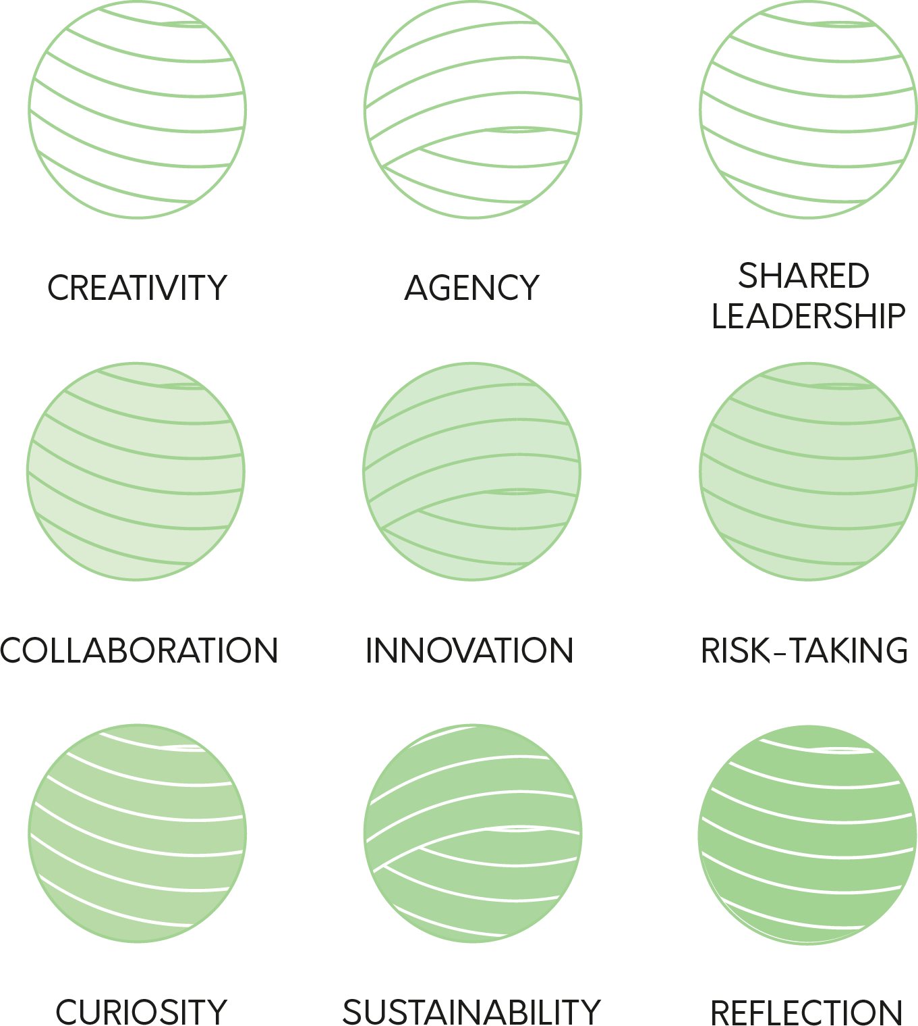
C-ACCELERATE CORE VALUES
The core values of C-Accelerate include collaboration, creativity, agency, shared leadership, innovation, risk-taking, curiosity, sustainability, and reflection. Together, these values represent the importance of teamwork and creativity, empowering individuals to take ownership of their ideas and act with a shared sense of responsibility. The project encourages innovation, taking risks, and embracing curiosity, while also focusing on sustainability and the importance of reflecting on progress.
These values come together to create an environment that fosters entrepreneurial and innovative thinking and prepares individuals for success in today's rapidly changing world. Having diversity and inclusion as a core value to the project will lead to a more equitable and
enriched experience for all participants. involved.
5

