Slide 1
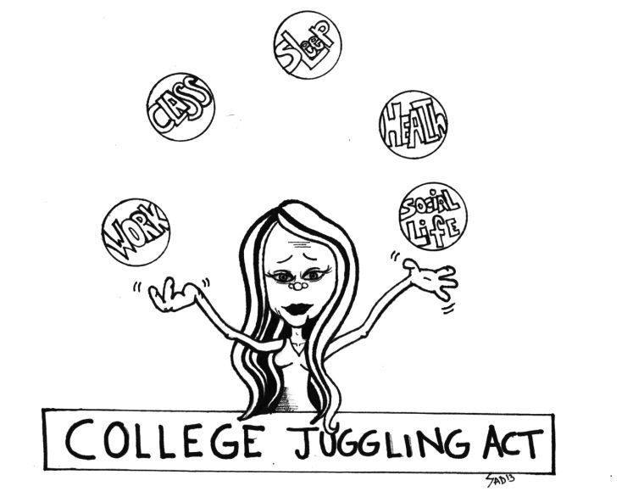
Time Management & Organisational Skills
Study Smart Workshop
Student Learning Centre

Slide 2

Aim of this session
Use Time Management strategies to help you:
Minimize stress
Make deadlines
Achieve your goals
Maintain quality in your work
Balance time between work, college, and personal life
Notes:
Are you getting your work done?
Are you happy with the quality of it?
Are you stressed out of your mind because things seem completely on top of you? If that sounds like you, you might benefit from time mgmt.
Time mgmt helps you achieve your goals, ensure that you turn out quality work that isn’t rushed as a result of time mgmt
And it also helps you balance your college workload with other aspects in your life. Nobody is expecting you to forget about other aspects of your life, but they may be out of balance with the amount of actual college work you get done.
So hopefully some time management will help you maintain the other things that are important to you as well as helping you get your college work done.

Slide 3
Getting Started
Obstacles
    Distractions
    Not knowing where to start
    Feeling overwhelmed
    Not knowing what you have to do
    Perfectionism
Notes:
Wasting time - Stopping to talk to someone for too long
Hanging around after studio talking to people
Cleaning and tidying
Cooking gourmet meals
Not coming back off your breaks
Facebook, imgur, 9gag

Slide 4
TIMETABLE EXERCISE
Fill in you’re classes, work shifts, hobbies etc. using the timetable template. Try using highlighters and different colours to identify specific tasks e.g. lectures= green, studiowork= yellow etc. This will give you an idea of where you have some free time or time to work on new projects etc.

Slide 5
Ten Tips to be better Organised
1. Identify tasks
2. Set simple, achievable goals
3. Stop making excuses
4. Set a deadline
5. Get rid of distractions
6. Time yourself
7. Take a break
8. Use incentives
9. Get the hard stuff done first
10. Tell someone about your goal

Slide 6

1. Identify tasks & Get Started
Invest in a wall planner (or use the calendar on your phone), a diary and/or a notebook to record important notes.
If you feel overwhelmed with all the things you have to do write them down - A TO-DO List
If your assignment isn’t due for a while make sure to write a start date in your calendar or diary.
Get started; Don’t overthink it, just start writing even if you know you will change it (that’s what drafts are for).

Slide 7
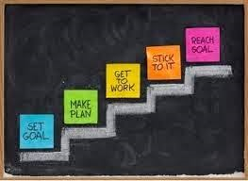
2. Set Simple, Achievable Goals
Break down your task or assignment into manageable chunks.
It’s always easier to get started on a project when you establish simple, reachable goals rather than a big, vague plan.
"I'll study biology tonight,” is better planned as "I'll study chapter six tonight."
This makes your goals less intimidating and more attainable.

Slide 8

2. Set, simple, Achievable Goals
Set a specific goal to work towards.
Set yourself personal deadlines to complete work
E.g. set yourself a deadline of 2 days in advance of the deadline then you have some extra time if anything comes up.

Slide 9
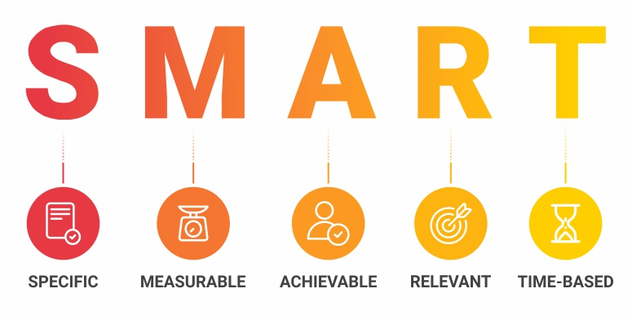
SET Smart goals

Slide 10
SMART or not-SMART?
I plan to do more study on a weekly basis so I can watch more Netflix at the weekend!

Slide 11

Not SMART!

Slide 12

The SMART way
I will spend my 2 hour break on a Monday morning preparing my assignment with the nearest deadline so that I won’t have to do it this weekend… and I can watch Netflix!

Slide 13
SMART or not-SMART?
I will spend my last hour in college on a Friday organising my notes from throughout the week
Notes:
Ask students is it specific- yes!
Measurable-(how will I know- my notes will be organised- yes!)
Achievable- Yes!
Realistic- yes- you may not choose Friday evening but you could pick a different time- even do it over lunch etc.
Timely- yes!

Slide 14
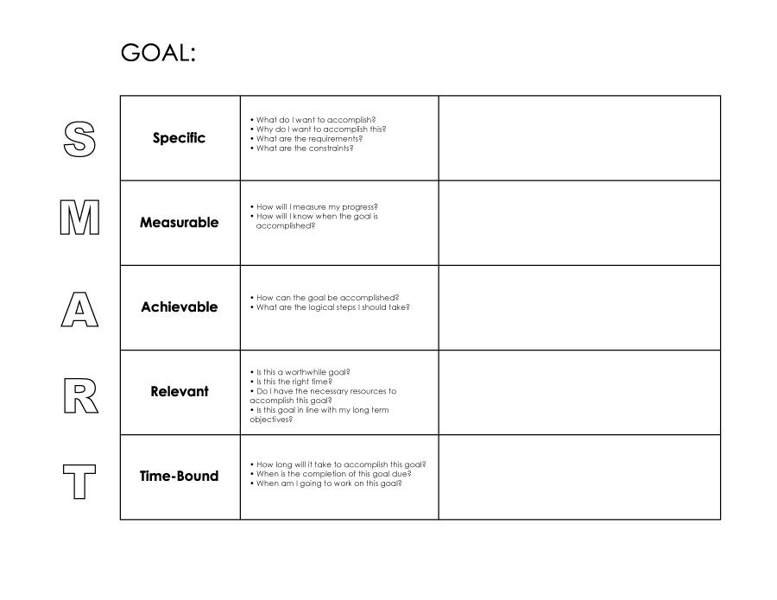
A Personal SMART Goal
Lets take a few minutes to think of a SMART Goal for this week…
  This can be based on anything that’s happening in your life at the minute e.g. work, studies, self-care etc.

Slide 15
3. Stop Making Excuses
Examples;
  “I would love to get that in ahead of schedule but it’s not possible because I’m so busy”
  “If I didn’t have X going on, I would be fine”
  “ I will wait to hear what others are doing before I start”
  “I haven’t got all my research done yet so I will wait”
  Stop waiting for the perfect moment- it doesn’t exist!

Slide 16

4. Create a Timeline/Schedule
Once you have identified your goals, create a timeline to achieve them.
  This could include a study plan, the breakdown of an essay etc.
  Remember you must be specific!
  Don’t forget to include some time for rest and fun.
  It’s important you stick to your timeline;
  Things will inevitably come up but don’t beat yourself up, instead take a breath, remind yourself that life happens and get straight back on track.

Slide 17

5. Minimize Distractions
E.g. Social Media or apps - shut your phone off (all the way off) or keep it out of sight e.g. in your bag etc. Turn off notifications!
Distractions could also be external sources, like people talking, typing etc. Try listening to relaxing music or white noise to cancel out the noise.
You might need to change your study environment. This could be the library or a quiet coffee shop, where you can clear your mind and study distraction-free.
Do you have a study space at home?
Notes:
Important to note that there is no right or wrong here. We all learn differently and have different preferences e.g. morning or evening person, noisy or silent, individual vs group study etc.

Slide 18

6. Set Time Limits
Work – life balance
If you stick to time limits you can enjoy your breaks guilt-free (just don’t forget to go back to studying!)
    E.g. I will study for 2hrs with no distractions and then can watch t.v. for 1 hr.
    Boosts self esteem and confidence

Slide 19

7. Take a Break
Take short regular breaks throughout the day;
    54321 exercise is good to help you take a quick 5 minutes out and re-focus
Studying and/or working doesn’t mean you have to give up all the things you love. You can still play sports and enjoy hobbies- we just need to manage our time more effectively.
If you are stressed and over-whelmed the best thing you can do is to take a break-go for walk, talk to someone, close your eyes for a few minutes, whatever works for you.
Notes:
Handout for 54321 exercise

Slide 20
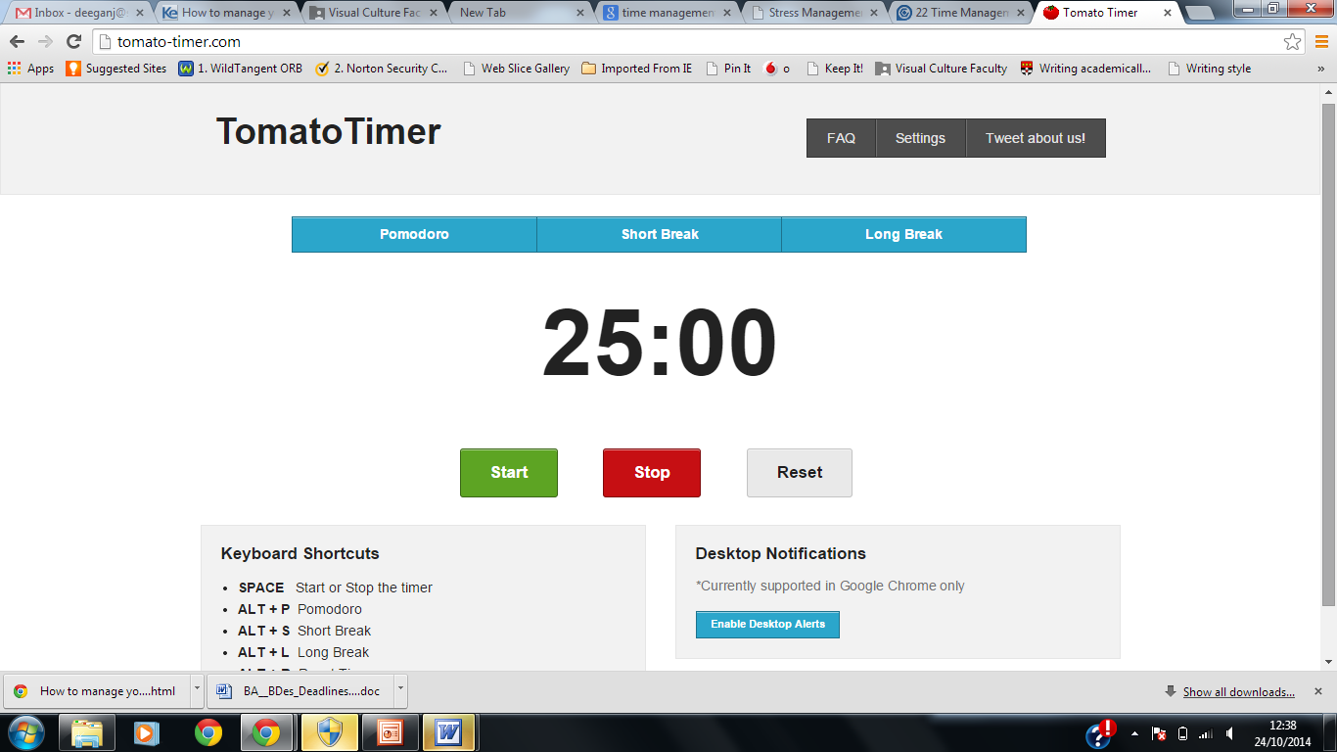
Breaks help keep you Motivated
Pomodoro Principle
25 mins work, 5 mins break
After doing this three times, give yourself a 15-20 min break
Get up, stretch, do something to get your blood flowing, give your eyes a break
Notes:
If you’re ability to stay going isn’t great, find a strategy that keeps you motivated. The pomodoro principle is structured into 25min spurts of productive work with a five min break, you do that three times then get a reward of a longer break.
When you do break, get some blood flowing and get up from your desk.

Slide 21

8. Use Incentives
We all need to be rewarded!!
Long-term goals can be difficult to work towards as they feel so far away.
It’s important to find what motivates you to get things done in advance rather than leaving things to the last minute.
Give yourself an incentive for reaching a goal e.g. if I get my assignment finished before I leave college today, when I go home I can binge watch Netflix all evening.

Slide 22

9. Get the Hard Stuff done first
It is very tempting to start the easier jobs and get distracted by easier jobs that are not as important.
Instead, identify the most challenging aspects of your assignments and start with them.
The longer you put it off, the more formidable it will seem.
This way everything after it seems easier and takes a shorter amount of time.

Slide 23

10. Tell Someone about your Goal
Seek the help of others to keep you accountable!
Tell a friend, partner or family about your plan and update them on your progress.
As an added bonus, you also have someone to celebrate your victories with, no matter how small!
Use each other as supports- link it with classmates to hold each other accountable.

Slide 24
Conclusions
Make a commitment – make deadlines and stick to them
Don’t overthink it-get started (try start with the hard stuff!)
Get active in the study process – e.g. join a study group
Action builds momentum – doing anything is much better than nothing.
Be realistic in what you set out to achieve.
Make use of any spare time – on the bus, waiting for an appointment.
Use positive thoughts and challenge negative thoughts
Look after yourself – mind and body. Take regular breaks.
Reward yourself regularly – do something you enjoy.

Slide 25

