Slide 1

Thesis Submission Checklist
Study Smart Workshop
Student Learning Centre
30th January 2020

Slide 2

Welcome & thank you for coming
Objectives for this workshop;
  Outline a checklist for submitting your thesis
    Structure
    Revision
    Important reminders
Everyone will keep track of their own personal checklist throughout

Slide 3

Who can relate?
Notes:
Writing a thesis is a challenge for all students and it takes a lot of hard work. Always reach out to your supervisors and peers when feeling stressed and remember that everyone is feeling the same way.

Slide 4


Slide 5

WARNING!
Always check your thesis guidelines and read your briefly thoroughly!

Slide 6
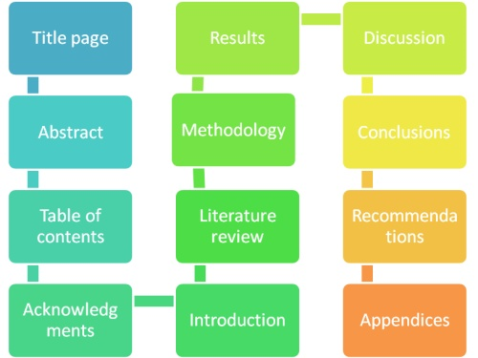
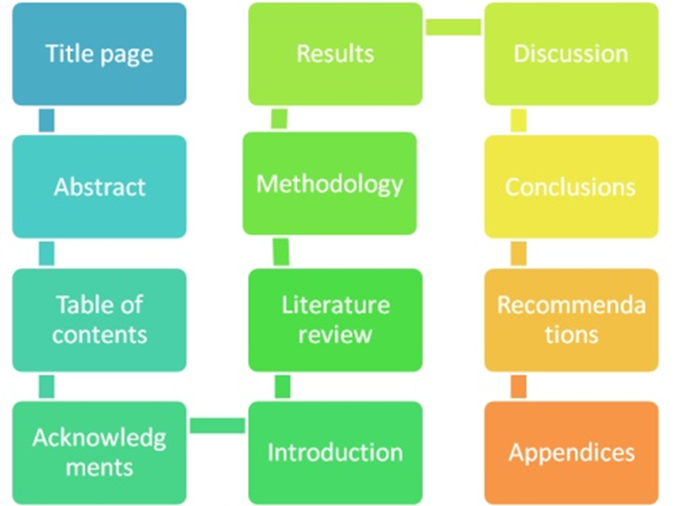

Have you included all areas?
References/ Bibliography
Notes:
Before submission check to see if you have included all the necessary sections.

Slide 7
As you revise your thesis, consider;
Do I answer the question?
Have I taken a position that others might challenge or oppose?
Is my thesis statement specific enough?
Does my thesis pass the “So what?” test?
Does my essay support my thesis specifically and without wandering?
Does my thesis pass the “how and why?” test?

Slide 8
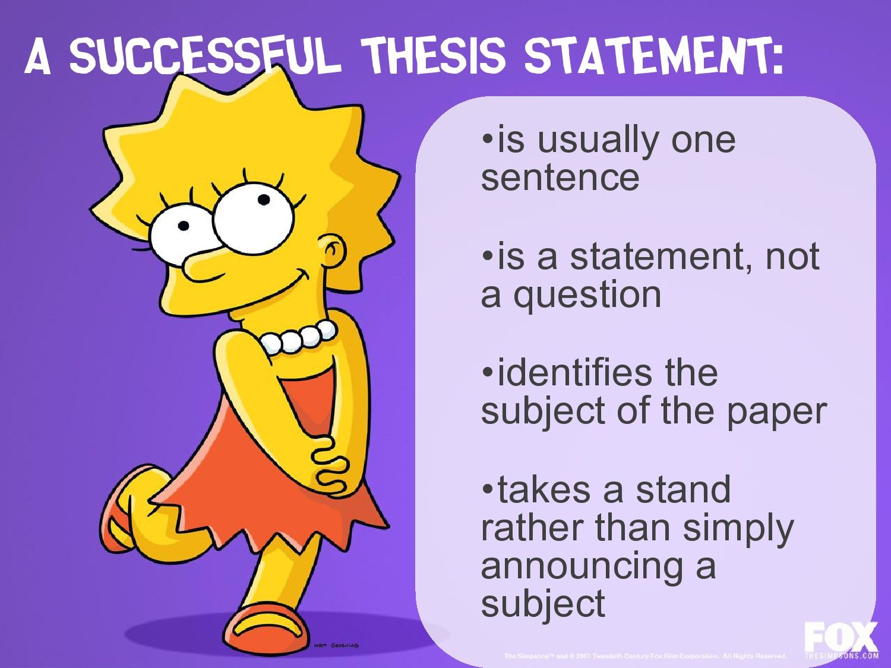
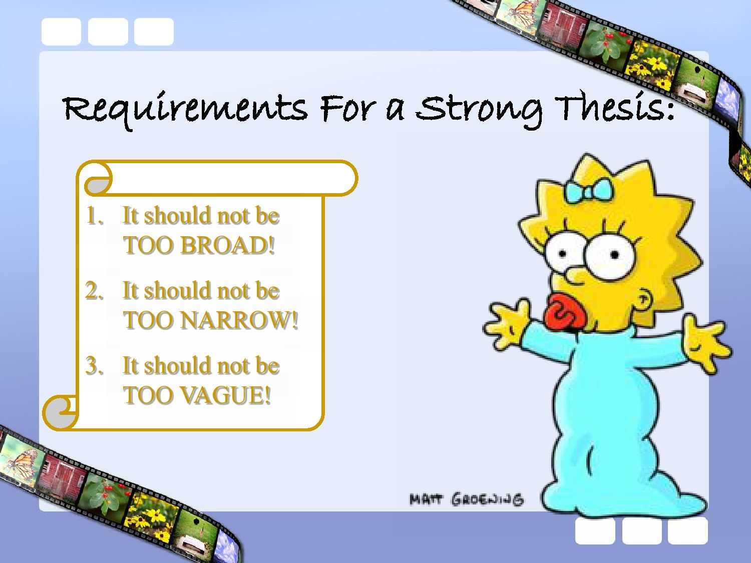
Thesis Statement

Slide 9
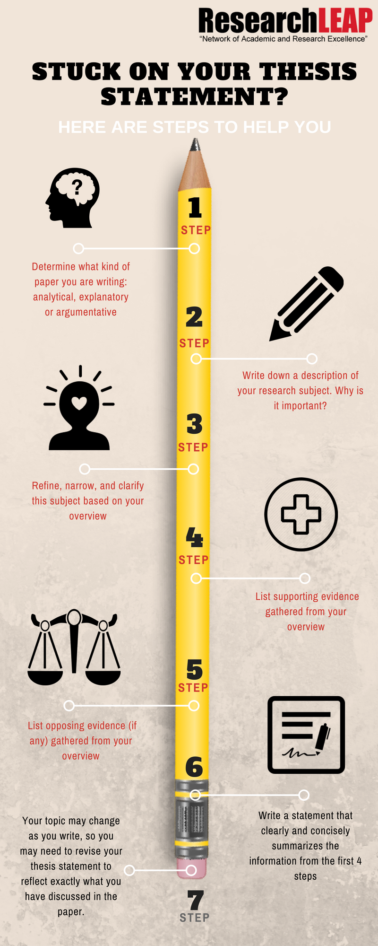

Slide 10
Guidelines on writing Abstracts
Self-contained, short, and powerful statement that provides a summary of your work. It should highlight the most important information.
Not a review, nor does it evaluate the work being abstracted. While it contains key words found in the larger work, the abstract is an original document rather than an excerpted passage.
Components vary according to discipline.
  An abstract of a social science or scientific work may contain the scope, purpose, results, and contents of the work. An abstract of a humanities work may contain the thesis, background, and conclusion of the larger work.

Slide 11

Guidelines on writing Abstracts
As a rule of thumb your abstract should include
  Your reason for writing
  Problem & Rationale
  Methodology (scientific paper)
  Results (scientific paper)
  Conclusions & Implications
Remember you must check your brief regarding specific details as these can change depending on the writing style.

Slide 12
Guidelines for writing an Introduction
  State the general topic and give some background
  Provide a review of the literature related to the topic
  Define the terms and scope of the topic
  Outline the current situation
  Evaluate the current situation (advantages/ disadvantages) and identify the gap
  Identify the importance of the proposed research
  State the research problem/ questions
  State the research aims and/or research objectives
  State the hypotheses
  Outline the order of information in the thesis
  Outline the methodology

Slide 13

Writing a good introduction
1. Identify your readership
2. Hook the reader and grab their attention
3. Provide relevant background
4. Give the reader a general knowledge of what the paper is about and questions you will answer/ aims of the paper
5. Preview key points and lead into thesis statement
Notes:
Before even starting with your first sentence, ask yourself the question who your readers are. Your first and most important reader is your professor grading your work and the people ultimately responsible for you getting your diploma. You should also consider readers of your thesis who are not specialists in your field. Writing with them in your mind will help you to be as clear as possible which will make your thesis better understandable and more enjoyable overall.
The first sentence of the paper is crucial. Looking back at your own research, how many papers have you skipped just because reading the first few sentences they couldn't grab your attention? It is common to start with a question or quotation, but these types of hooks have become overused. The best way to start your introduction is with a sentence that is broad and interesting and seamlessly transitions into your argument. Also, starting with a broader statement will appeal to a wider audience. Consider who the paper is aimed at informing and then think of something that would grab their attention. Make a list of what is interesting about your topic. Are there any current events it relates to or controversies associated with it that might be interesting for your introduction? Start out broad and then narrow down to your specific topic and thesis statement.
A good introduction also needs to contain enough background information to allow the reader to understand the thesis statement and arguments. The amount of background information required will depend on the topic. There should be enough background information so you don't have to spend too much time with it in the body of the thesis, but not so much that it becomes uninteresting.
Let the reader know what the purpose of the study is. Make sure to include the following points:
Briefly describe the motivation for your research (if you haven't already in the first sentence)
Describe the topic and scope of your research
Explain the practical relevance of your research
Explain the scientific situation related to your topic - you can include the most important scientific articles and briefly explain them and how they are related to your research
The introduction to your thesis should preview what is to come and interest the reader with enough understanding of the key points, but still leave the best for the main part. While the body of your thesis will explain the main argument, you might want to lead into the thesis statement by briefly bringing up a few of your main supporting details.

Slide 14
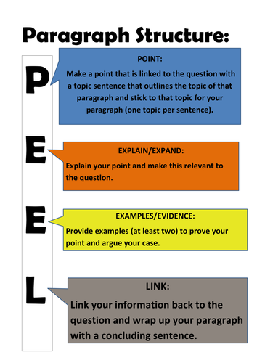
Check your paragraph structure
Notes:
Use the PEEL technique as a guide to check your paragraphs are well structured. Remember there should be one general theme/idea for each paragraph.

Slide 15
Have you supported all arguments?
Claim + Supporting evidence+ argument indicators + conclusion= Argument
Example:
  Claim: Students with poor attendance fail more exams…
  Supporting Evidence: …as can be seen in university statistics.
  Argument Indicator: As a result, it can be concluded that…
  Conclusion: …attendance is a factor in achieving good results.
Notes:
Your thesis statement should be a running theme throughout your thesis. Make sure each argument you present is coherent, clear and supported with evidence from the literature. Finally you will need to evaluate and conclude how your argument relates to your overall thesis statement.

Slide 16
Verbs or “bolts”
Verbs are the bolts that you will use to hold your argument together. They are usually used in the present tense e.g. Bruner (1986) claims….
Examples of Verbs;
  Advocates
  Argues
  Agrees
  Claims
  Emphasizes
  Indicates
  Highlights
  Expands
  Proposes
  Warns
  Suggests
  Recommends
  Reports
  Confirms
Notes:
Use a variety of verbs when making your argument.

Slide 17

Argument indicators as ‘Signposts’
Argument indicators act like signposts pointing towards an argument you are making e.g. Running on icy surfaces is dangerous, so it is important to proceed cautiously.
Examples;
  Since
  Because
  For
  Thus
  Therefore
  It follows that
  As a result, it can be concluded that
  This would suggest that
  If…then…
Notes:
Again try use a variety of argument indicators so you do not sound repetitive.

Slide 18
Guidelines on writing a Conclusion
You should not underestimate the importance of your conclusion. The conclusion is the last thing that your reader will see, so it should be memorable. You will get more marks!
Make sure to dedicate enough of your writing time to the conclusion and do not put it off until the very last minute.
Remember at 3rd level we are not simply describing research but critically evaluating the information.
A good conclusion will:
  Review the key points of the dissertation
  Explain to the reader why the information is relevant, applicable, or related to the world as a whole.

Slide 19

Writing a good Conclusion
Thesis introduction starts out with broad statements about the topic and then narrows it down to the thesis statement, a thesis conclusion does the same in the opposite order:
1. Restate the thesis
2. Review or reiterate key points of your work
3. Explain why your work is relevant
4. A take-home message for the reader

Slide 20
Writing a good Conclusion
Additional tips:
  1. Do not summarize too much
  2. Be careful when introducing new information
  3. Do not use your conclusion to make up for inadequacies in the body of your paper
  4. Beware of using the word "conclusion" in your thesis
  5. Be careful when giving your own opinion

Slide 21
General tips to stay focused
Talk your thesis. Tell a friend what your paper is about. Pay attention to your explanation. Are all of the ideas you describe actually in the paper? Where did you start in explaining your ideas. Does your paper match your description? Can the listener easily find all of the ideas you mention in your description?
Ask someone to read your paper out loud to you. Ask a friend to read your draft out loud to you. What do you hear? Where does your reader stumble? Sound confused? Have questions? Did your reader ever get lost in your text? Did ideas flow in the order the reader expected them to? Was anything missing for the reader? Did the reader need more information at any point?

Slide 22

Key Points to Remember
Stay calm & set SMART goals; Specific, Measurable, Achievable, relevant and time-bound.
Write your thesis statement and objectives of your research on a page in large font and hang it on your wall. Every time you write something ask yourself is this relevant to your thesis statement or does it help one of my questions.
Stay focused and follow your plan
Proof read your draft out loud (ask a peer)
Remove (“I”, “We”)
Re-draft/re-read/repeat
Remember!
Check that you have referenced all of your material correctly and accurately
Spell check your work before printing

