Slide 1

Research & Referencing
Study Smart Workshop
16th of January 2020

Slide 2

Welcome & thank you for coming
Objectives for this workshop;
  Why is research important for assignments?
  Researching tips
  Referencing & general tips

Slide 3

Why research topics?
Important component of your assignment preparation process.
Through reading and thinking about that material and writing it in your own words that your learning is increased and also demonstrated to your lecturer.
  Saves time
  Produces more relevant results
  Allows you to evaluate information
  Increases your knowledge base
  Gets you better grades

Slide 4

Research Techniques
Research is pretty easy – visit a website or two, find some quotes and your assignment is on its way, right?
Maybe….but if you put in a little more effort, you'll find better information faster and hand in a better assignment. There are a number of things you can do to break down research tasks into manageable parts and find reliable information.

Slide 5

Define the Task
Good research begins with good preparation
Define Research Problem/ task. Try to understand exactly what the question is asking, so you know how to answer it really well.
Read your brief carefully
Before starting to research, ensure you haven’t missed any key parts of the assignment.
Identify key ideas and concepts
Identify what you kind of information you want to know about and essential information.

Slide 6

Create a Search Plan
You will need a search plan to begin your search for information.
Go back to your assignment brief. Again, ask yourself what is the question and what information do you need to answer the question?
Highlight key words and begin making a list of keywords for each concept
Include similar words (synonyms) or alternative spellings.

Slide 7
Example
Compare and contrast two communication models and discuss how they are used in advertising practice. Identify two examples to support your findings.
Every word in the brief is important. Use a highlighter to identify the key directive words
  Compare and contrast two communication models and discuss how they are used in advertising practice . Identify two examples to support your findings.

Slide 8
Example
Use a different highlighter and underline what you are expected to write about.
Compare and contrast two communication models and discuss how they are used in advertising practice . Identify two examples to support your findings.

Slide 9
Example
This question is asking you to look at two communication models and discuss how these are used in practice in the role of professional advertising agencies.
Search Plan
  1. You must find the two models
  2. Assess their validity or usefulness
  3. Identify two examples of advertising in which the theories are recognisable to you. In other words, you need to demonstrate how these theories are used in practice.

Slide 10
Let’s try another one…
Modern smartphones have developed into multi-purpose mobile computing devices. Discuss 2 advantages and 3 disadvantages modern mobile-phone technology has contributed to human’s lives?

Slide 11
Locate relevant resource material
What sources are available? What are the best sources to use? Identify what to look for and where to find it.
Library catalogues, databases, bibliographies, search engines, recommended texts , books , journals, images, people,
Decide search terms and research parameters

Slide 12

Search terms on databases

Slide 13
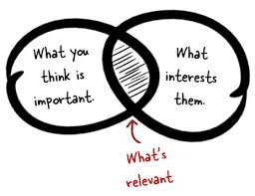
Select Material to Use
The information collected during the location stage may show that you need to redefine or refocus your research.
Selection and evaluation of resources takes place during the location stage, but it is often better to collect more information than you need, at least initially.
Careful evaluation of the materials is necessary to ensure they are appropriate, authoritative and relevant to your brief.

Slide 14
Tips for Selecting Material
Identifying the source of the information
Focusing on the assignment topic to determine the objectivity, accuracy, suitability and academic merit of the information
Skimming and scanning resources to sort information into categories
Taking brief notes and observing how different sources may relate to one another
Identifying questions or areas which may require further research
Establishing which are your principal and supplementary resource materials.

Slide 15

Organising (sorting/structuring)
This step of the research process requires a more detailed reading of the resource material and the development of a structure for the assignment. Here, the skills of note-taking and arranging information are necessary,

Slide 16
Tips for Organising your Research
Keep your notes focused on the topic
Write in your own words (This will save you time later)
Sort information into categories
Consider how various elements of the topic connect to one another
Establish a detailed plan or outline of the assignment
Develop an argument (NB to critically evaluate info)
Use quotations effectively and sparingly
Reference as you go!

Slide 17
Tips for Organising your Research
Name of Author | Year | Article or Book title | Journal Title or Publisher name | Place of Publication | Page Numbers used | Volume & Issue No. (Journals) | Section of essay used/ Themes

Slide 18






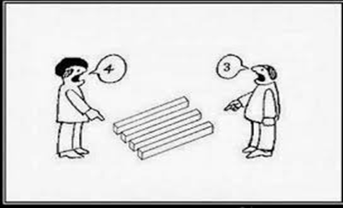



Why do I need to Reference?

Slide 19
When do I need to Reference?
ALL THE TIME!!!

Slide 20

3 types of in text references
Direct Quote
Paraphrasing
In text reference

Slide 21

Direct Quotes
A direct quote is when you have written exactly what you have read
  Let’s look at an example from an article by McCarthy, Kelly and Johnson (2012)
  Example Quote; McCarty et al. states that “Pipe deterioration is considered to be a complex process, which is influenced by a huge amount of factors” (2012, p. 34).
Notes:
You can use ‘et al’ if there is more than two authors for in text references.
Note- you will need to state all authors names in the bibliography reference (as per your handout template).

Slide 22
Longer Quotations
  Pattell et al. (1998) highlight the unnecessary nature of the violence enacted by the rebels:
  The violent nature of rebels attacks seemed to be somewhat senseless. The murdered women and children who were doing little more than seeking refuge nearby. They showed little remorse for their acts and seemed to revel in their destruction of human
  life (p. 451).

Slide 23
Paraphrasing
What is Paraphrasing?
  Rewriting information in your own words.
  Summarising what the author said in a different way
Example:
An article by McCarthy et al (2012) states that “Pipe deterioration is considered as a complex process, which is influenced by a huge amount of factors” (p. 34) (direct quote)
McCarthy et al (2012) state that pipe deterioration can be influenced by many factors and is understood to be a complicated process. (paraphrased)

Slide 24
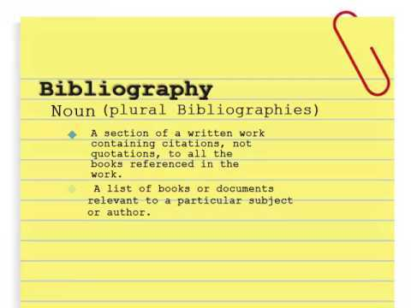
Do I need to reference anywhere else?
Yes!

Slide 25
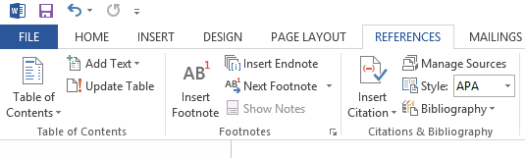
What is a bibliography?
Provide the full information for someone, if they wanted to look up the authors you cited in text.
Microsoft word has a feature to add your bibliography using your footnotes and in text references. This can be found under the ‘References’ tab.

Slide 26

Things to remember…
Referencing is not as scary as it seems.
If in doubt, REFERENCE!
Use websites such as TurnItIn to check for plagiarism
Check the referencing style before starting.
Reference as you go!

Slide 27

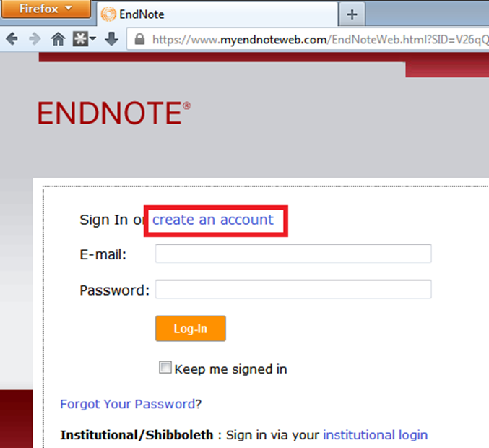

Slide 28
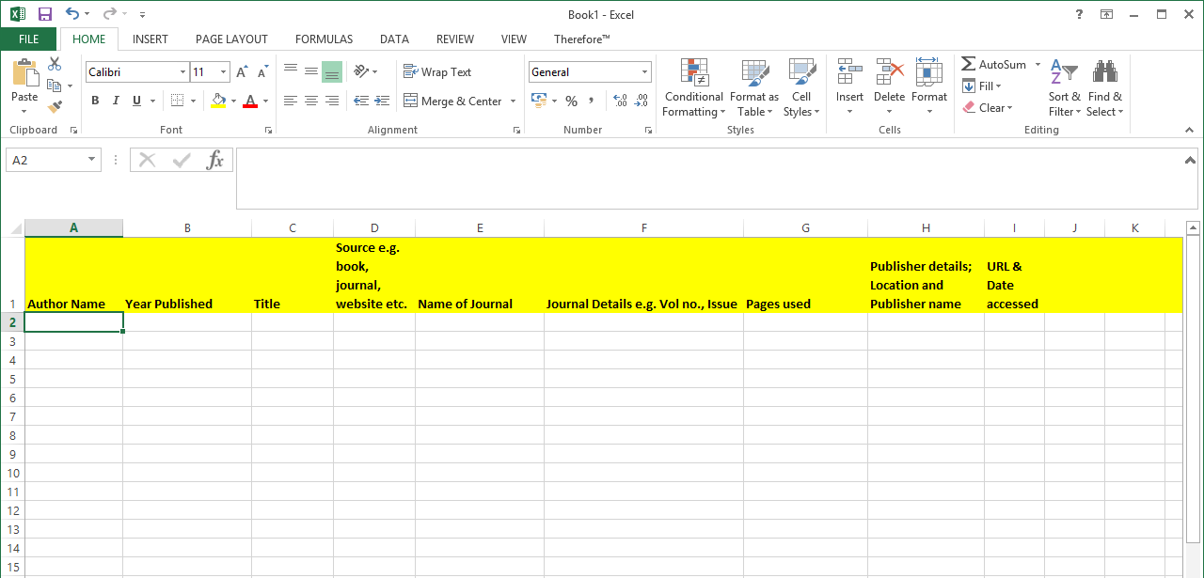

Slide 29
Different Styles of Referencing
There are lots of different types of referencing and it is important you link in with your lecturers to check which style of referencing you should use if unsure.
Examples:
  Chicago
  APA
  Harvard
  MLA
  Oxford

Slide 30

Top Tips
Website to help you cite all resources available on http://www.citethisforme.com/guides
Find your reference on Google scholar. Click on the ‘cite’ link and you will get all the info you need to reference!

Slide 31
Booking an Appointment
List the free times in your timetable & send to:
  Email: learningdevelopment@iadt.ie
  Phone: 01 239 4790 or 0871023215
For example: My free times this week are; Mon, 9-11am and 12-1pm and Tues, 11am-1pm.

