Slide 1


Referencing
Study Smart Workshop
Student Learning Centre

Slide 2

Welcome & thank you for coming
Objectives for this workshop;
  Why we need to reference
  How to reference
  Avoiding plagiarism

Slide 3






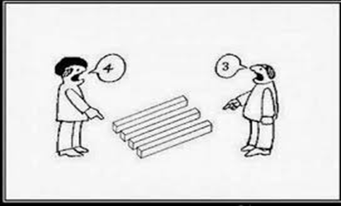



Why do I need to Reference?
Notes:
Referencing other people’s work provides support for your argument. Referencing also shows that you have worked hard to research your topic well and therefore you will get more marks. It is important to give credit to other’s hard work and avoid plagiarism. Researching and referencing different views and studies helps show that people have different views on the same topic.

Slide 4
When do I need to Reference?
ALL THE TIME!!!

Slide 5
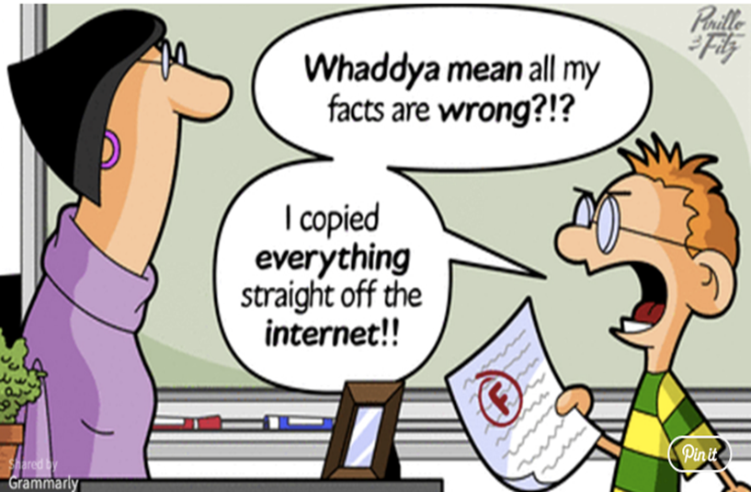
When is all the time?!
Whenever you are making a statement that you have:
Read somewhere
Heard in a lecture
Or any form of knowledge that you need to support
For example: Children benefit from play as it helps their imagination and to develop their motor skills.
ASK YOURSELF- how do I know this to be true?

Slide 6
When is all the time?!
Always support your points with evidence (i.e. what you have read).
Any point which consists of information from somewhere other than your own thoughts must be referenced!
Example:
Common Knowledge: It is widely accepted that the sky is blue (No Reference)
Reference Required: Many scientists throughout history have attempted to explain the colour of the sky (Hoeppe 2007, p. 17)

Slide 7

It’s not as scary as it seems!
What do you always need?
  The author’s name
  The year it was published
  The title/ journal details
  Who published it
  Where it was published
  The pages you used

Slide 8

3 types of in text references
Direct Quote
Paraphrasing
In text reference

Slide 9
Direct Quotes
A direct quote is when you have written exactly what you have read
  Let’s look at an example from an article by McCarthy, Kelly and Johnson (2012)
  Example Quote; McCarty et al. states that “Pipe deterioration is considered to be a complex process, which is influenced by a huge amount of factors” (2012, p. 34).
Notes:
You can use ‘et al’ if there is more than two authors for in text references.
Note- you will need to state all authors names in the bibliography reference (as per your handout template).

Slide 10
Longer Quotations
  Pattell et al. (1998) highlight the unnecessary nature of the violence enacted by the rebels:
  The violent nature of rebels attacks seemed to be somewhat senseless. The murdered women and children who were doing little more than seeking refuge nearby. They showed little remorse for their acts and seemed to revel in their destruction of human
  life (p. 451).

Slide 11
Paraphrasing
What is Paraphrasing?
  Rewriting information in your own words.
  Summarising what the author said in a different way
Example:
An article by McCarthy et al (2012) states that “Pipe deterioration is considered as a complex process, which is influenced by a huge amount of factors” (p. 34) (direct quote)
McCarthy et al (2012) state that pipe deterioration can be influenced by many factors and is understood to be a complicated process. (paraphrased)

Slide 12
Paraphrasing Tips
The five steps to paraphrasing may seem straightforward, but writing an idea in a different way than the published version can be difficult. These are four tricks you can apply to help you do so.
Start your first sentence at a different point from that of the original source
  Use synonyms (words that mean the same thing); If you’re struggling to think of synonyms, a thesaurus can be a useful tool. However, don’t overdo it! It’s perfectly acceptable and often necessary to use some of the same words as the original text.

Slide 13
Paraphrasing Tips
  Break the information into separate sentences
Change the sentence structure; For example, if the sentence was originally in the active voice, change it to passive. The active voice is when a sentence is led by the subject (the thing doing the action). When the object (the thing receiving the action) leads the sentence, that sentence is written in the passive voice.
  “technology outpaces what users, regulators or even its creators expected” → “the expectations of creators, regulators and users have been rapidly eclipsed by technology“

Slide 14
Avoiding plagiarism
When paraphrasing, you have to be careful to avoid accidental plagiarism e.g. the paraphrase is too similar to the original quote, with phrases or whole sentences that are identical (and should therefore be in quotation marks). It can also happen if you fail to properly cite the source of the paraphrase.
To make sure you’ve properly paraphrased and cited all your sources, you could elect to run a plagiarism check before submitting your paper.

Slide 15
In-Text Referencing
Basic Formula: Bracket - Surname - Comma – Year – Comma- p- Full stop - Page number- close bracket
e.g.(O’Doherty, 2012,p.4).

Slide 16

Do I need to reference anywhere else?
Yes!

Slide 17
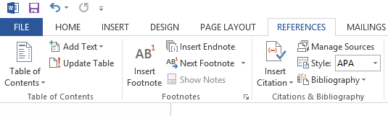
What is a bibliography?
Provide the full information for someone, if they wanted to look up the authors you cited in text.
Microsoft word has a feature to add your bibliography using your footnotes and in text references. This can be found under the ‘References’ tab.

Slide 18
Things to remember…
Referencing is not as scary as it seems.
If in doubt, REFERENCE!
Use websites such as TurnItIn to check for plagiarism
Check the referencing style before starting.
Reference as you go!

Slide 19
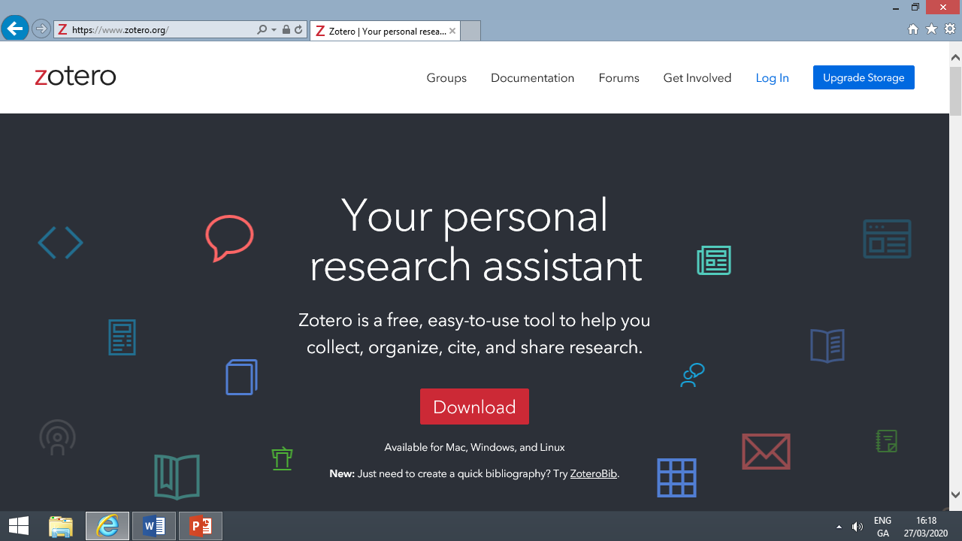
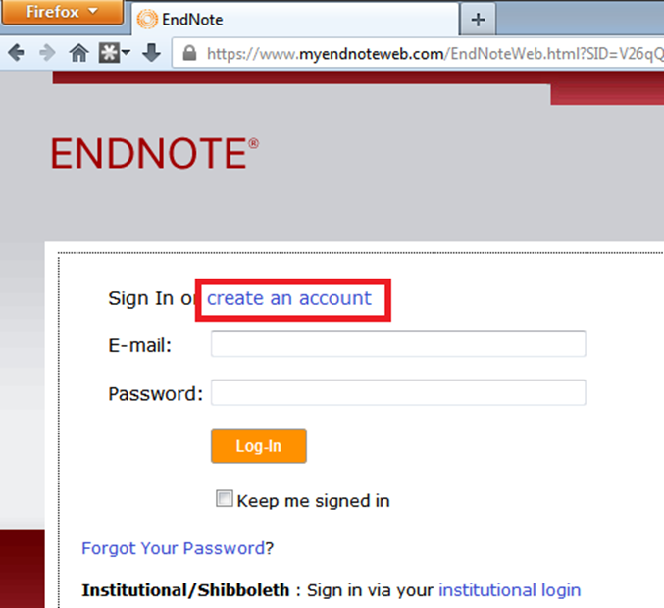

Slide 20
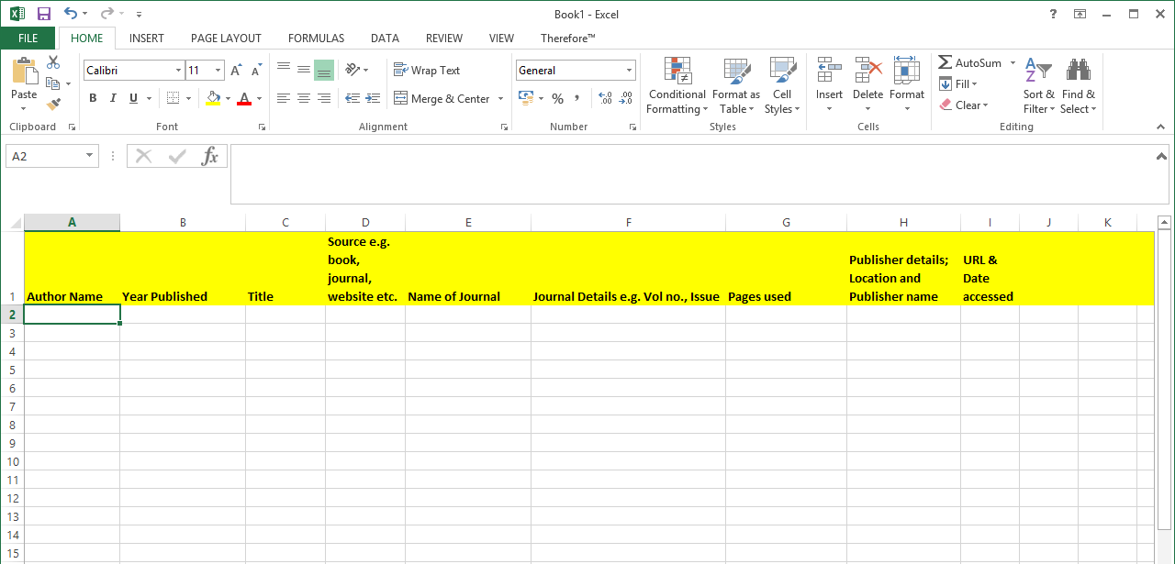

Slide 21
Footnotes & Endnotes
Footnotes and endnotes are both ways of adding extra bits of information to your writing outside of the main text. Think of them like verbal asides, only in writing. You can use footnotes and endnotes to add side comments to your work or to cite other publications like books, articles, or websites. The only difference between footnotes and endnotes is where they appear in your document.
As the name suggests, footnotes are attached to the bottom of the page containing the sentence they correspond to. Endnotes, on the other hand, are added to the end of a section or document. Which one you should use in your writing depends on your personal preference or—if you’re writing for school or work—your organization’s publication standards.

Slide 22
Footnotes in Word
Open the document in Microsoft Word to which you’d like to add footnotes (or create a new document if you’re just getting started). Switch to the “References” tab on Word’s Ribbon.
Here, you’ll find a bunch of useful features for annotating your text, including tools for inserting a table of contents, adding citations, and generating a bibliography. The second group on this tab contains the footnote and endnote features we want.
To add a footnote, place your insertion point in your text where you want the footnote to appear, and then click the “Insert Footnote” button.
Word adds a small superscript number where you placed the insertion point.
And then immediately shifts focus to the footnote pane and places the insertion point at your new footnote, so you can start typing it right away.
Footnotes appear at the bottom of the page beneath a short horizontal line. Each time you add a footnote on this page, another number will be added to the list.
How to guide available on https://www.howtogeek.com/359187/how-to-use-footnotes-and-endnotes-in-microsoft-word/

Slide 23
Harvard Referencing
Harvard is a style of referencing, primarily used by university students, to cite information sources. The following examples are based on Harvard style.
Two types of citations are included:
In-text citations are used when directly quoting or paraphrasing a source. They are located in the body of the work and contain a fragment of the full citation.
Reference Lists are located at the end of the work and display full citations for sources used in the assignment.
Here is an example of a full citation for a book found in a Harvard Reference list:
Fitzgerald, F. (2004). The great Gatsby. New York: Scribner.

Slide 24
Books
Reference lists are created to allow readers to locate original sources themselves. Each citation in a reference list includes various pieces of information including the:
  Name of the author(s)
  Year published
  Title
  City published
  Publisher
  Pages used
Generally, Harvard Reference List citations follow this format:
  Last name, First Initial. (Year published). Title. City: Publisher, Page(s).
Citations are listed in alphabetical order by the author’s last name.
If there are multiple sources by the same author, then citations are listed in order by the date of publication.

Slide 25
Journal Articles
When citing journal articles found on a database or through a website, include all of the components found in a citation of a print journal, but also include the medium ([online]), the website URL, and the date that the article was accessed.
Structure:
  Last name, First initial. (Year published). Article Title. Journal, [online] Volume(Issue), pages. Available at: URL [Accessed Day Mo. Year].
  Example:
    Raina, S. (2015). Establishing Correlation Between Genetics and Nonresponse. Journal of Postgraduate Medicine, [online] Volume 61(2), p. 148. Available at: http://www.proquest.com/products-services/ProQuest-Research-Library.html [Accessed 8 Apr. 2015].

Slide 26

Websites:
When citing a website, use the following structure:
  Last name, First initial (Year published). Page title. [online] Website name. Available at: URL [Accessed Day Mo. Year].
When no author is listed, use the following structure:
  Website name, (Year published). Page title. [online] Available at: URL [Accessed Day Mo. Year].
Example:
Messer, L. (2015). 'Fancy Nancy' Optioned by Disney Junior. [online] ABC News. Available at: http://abcnews.go.com/Entertainment/fancy-nancy-optioned-disney-junior-2017/story?id=29942496#.VRWbWJwmbs0.twitter [Accessed 31 Mar. 2015].

Slide 27

Films
When citing a DVD, Video, or Film, use the following format:
  Film title. (Year published). [Format] Place of origin: Film maker.
  **The place of origin refers to the place where the dvd, film, or video was made. Eg: Hollywood
  **The film maker can be the director, studio, or main producer.
Example:
Girls Just Want To Have Fun. (1985). [film] Chicago: Alan Metter.

Slide 28
Artwork
To cite artwork, use the following structure:
  Last name, First initial. (Year created). Title. [Medium]. City that the artwork is/was displayed in: Gallery or Museum.
Examples:
Gilbert, S. (1795-1796). George Washington. [Oil on canvas] New York: The Frick Collection.
Jensen, L., Walters, P. and Walsh, Q. (1994). Faces in the Night. [Paint Mural] Trenton: The Trenton Free Library.

Slide 29
E-books & PDFs
When citing eBooks and PDFs, include the edition, even if it’s the first edition, and follow it with the type of resource in brackets (either [ebook] or [pdf]). Include the url at the end of the citation with the date it was accessed in brackets.
Use the following structure:
  Last name, First initial. (Year published). Title. Edition. [format] City: Publisher, page(s). Available at: URL [Accessed Day Mo. Year].
Examples:
Zusack, M. (2015). The Book Thief. 1st ed. [ebook] New York: Knopf. Available at: http://ebooks.nypl.org/ [Accessed 20 Apr. 2015].
Robin, J. (2014). A handbook for professional learning: research, resources, and strategies for implementation. 1st ed. [pdf] New York: NYC Department of Education. Available at http://schools.nyc.gov/ [Accessed 14 Apr. 2015].

Slide 30
Examples of APA style referencing
Book: Brookes, R. (2014). Study Guide Little Bird (p. 5). Adelaide: State Ed.
Journal: Esen, E., & Collison, J. (2005). Employee development survey report. Society For Human Resource Management, V(A), 4.
Website: About.com Islam,. (2014). Evils of Gossip and Backbiting in Islam. Retrieved 12 June 2014, from http://islam.about.com/od/familycommunity/a/Gossip-Backbiting.htm

Slide 31

Top Tips
Website to help you cite all resources available on http://www.citethisforme.com/guides
Find your reference on Google scholar. Click on the ‘cite’ link and you will get all the info you need to reference!

Slide 32

Let’s test our knowledge…
Let’s practice referencing…
https://www.ncl.ac.uk/library/assets/external/teaching/referencing_quiz.html

Slide 33

Conclusions
It is not as scary as it seems. If in doubt, REFERENCE!
Use websites such as TurnItIn to check for plagiarism
Make sure to check which referencing style your lecturer wants.
It is easier to reference as you go- use footnotes and don’t leave your entire bibliography until the day before the deadline.

Slide 34
Booking an appointment
List the free times in your timetable & send to:
  Email: learningdevelopment@iadt.ie
  Phone: 01 239 4790 or 0871023215
For example: My free times this week are; Mon, 9-11am and 12-1pm and Tues, 11am-1pm.

