Slide 1
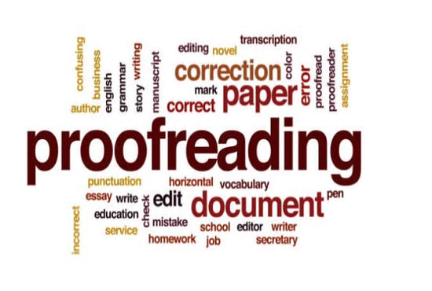
Revising,
Editing
&
Proofreading
Study Smart Workshop
Student Learning Centre

Slide 2
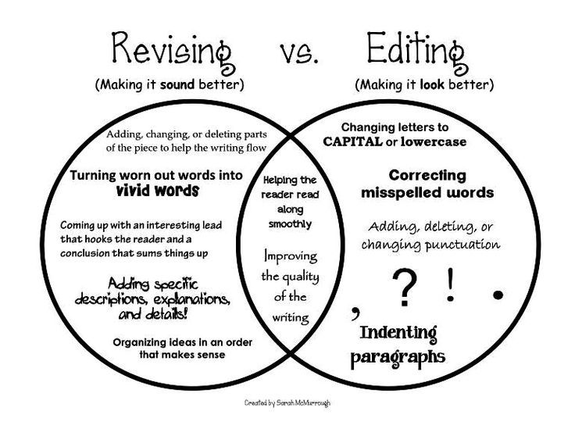

Slide 3
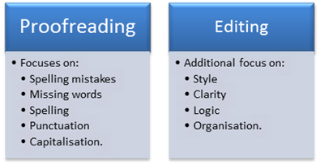

Slide 4
First Steps
1. Read & re-read (Highlight the important words)
-Your assignment sheet
-Your criteria sheet
-Other information from your teacher
2. Check that you have specifically answered the question and completed all aspects of the task.
E.g. evidence statements, sourcing, bibliography.

Slide 5
Revising
The rough draft is evaluated for the larger issues of general content, organization, and tone, by adding, deleting, and organizing information as necessary. Ask yourself;
Who is your audience?
Why are you writing about this topic?
How does the information come across? Does it flow in a logical way? Is it clear and concise?
Will your audience be able to understand what you've written?
Are you objective enough?
Have you balanced your arguments? Have you covered both sides?
Have you included enough information?
Have you backed up your points with solid evidence?
Do you have more information than you need?
Have you answered all aspects of the assignment brief?
Have you went into enough detail or too much? Is it too specific or too broad?

Slide 6
Editing
You will have numerous drafts for each assignment-this is normal.
Track your changes using Track Changes function in Word
Read over your writing, over and over again.
  Make sure to leave some time between reads. This will help you get a fresher look at it and you will notice mistakes more easily.
Editing looks at the essay as a whole. Looking at the;
  Structure
  Content
  Style (Expository, Descriptive, Persuasive, Narrative)
  Sources of information

Slide 7
Proofreading
Looks at the detail;
  Word choice
  Grammar
  Spelling
  Punctuation
You might not be able to identify your own mistakes, ask a peer, friend or family member to read your work.

Slide 8
Structure
Check for;
Introduction
  Have you introduced the topic well
  Did you identify the aims of your essay/thesis
Main Body
  Each paragraph should develop one idea.
  All points should be supported by evidence.
Conclusion
  The points in the body of your assignment should be summarised.
  Repeat the main point of the assignment.

Slide 9
Word Choice
Question: Is my assignment clear in meaning?
Be concise
Used specialised language
Avoid words you don’t know
Remove slang
Don’t use words repetitively

Slide 10
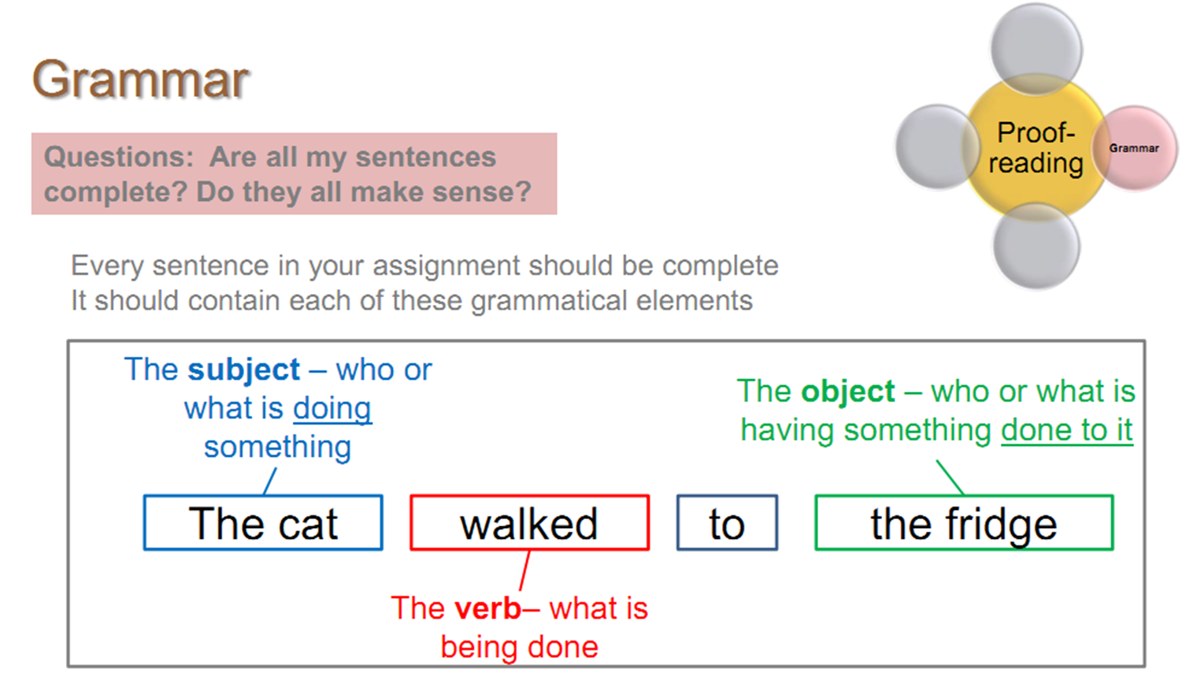
Grammar
Questions - Are my sentences complete?
- Do they make sense
Every sentence in your assignment should be complete.
It should contain each of these grammatical elements.

Slide 11
Sentences
Ask yourself;
Do my sentences contain only one idea? Are they too long and complicated?
A sentence should only have one point.
Try not to have a sentence that runs for more than two or three lines. If it is too long, divide it into more than one sentence.
Are you wordy, repetitive, or inconsistent?
Do you have any incomplete thoughts?

Slide 12
Punctuation
Ask yourself; Have I punctuated my sentences correctly?
Commas are typically used for:
separating adjectives (The small, frightened mouse).
Apostrophes indicate either;
letter of a word has been left out (e.g. you’re/ who’ll)
The ownership of something (e.g. Laura’s wallet)

Slide 13
Spelling
Check– Is my spelling correct?
Spelling is the least important part of your assignment, but the most visible.
Use a spell checker, but do not rely on it.
Check your work by reading it backwards – you tend to focus less on the meaning of the words and more on the spelling.

Slide 14
Capitals
Capitalize the First Word of a Sentence
Capitalize Names and Other Proper Nouns
Don’t Capitalize After a Colon (Usually)
Capitalize the First Word of a Quote (Sometimes)
Capitalize Days, Months, and Holidays, But Not Seasons
Capitalize Most Words in Titles
Capitalize Cities, Countries, Nationalities, and Languages
Capitalize Time Periods and Events (not centuries or the numbers before them)

Slide 15
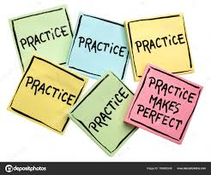
Let’s Practice…

Slide 16
Proofreading tips
Do not be afraid to read your assignment out loud. If it doesn’t sound right, then it probably isn’t.
Even in exam conditions, you should read your essay to yourself. You do not need to read it aloud, however you should actually mouth each word.
Read assignment backwards.
Don’t proofread for every type of mistake at once.

Slide 17
Proofreading tips
Read it slowly
Point with your finger to proofread one word at a time
Give yourself enough time to proofread.
Work from a print out-easier to identify mistakes!

Slide 18
Formatting tips
File format
  Most assignments should be written on MS Word, PDF or Google Pages.
Page numbers (at the bottom of the page)
Fonts
  Black text with white background.
  Clear & readable (Times New Roman or Arial)
  Use 11 or 12 point for the body of your assignment.
  Justified

Slide 19
Formatting tips
Spacing
  Use 1.5 or double spacing and fairly wide margins. This leaves room for the marker’s comments.
  Leave a blank line between paragraphs.
Title page
  The title of the assignment
  The course number and name
  The due date
  Your full name and student number.

Slide 20


Slide 21

Conclusions
Aim to print a copy of your assignment with some time before your deadline to proof-read. Give yourself enough time to do this and don’t leave it until the last minute.
Could ask classmates to read each other’s work the week of submissions
Remember to check for only one type of mistake at once e.g. sentences, spelling or grammar etc.

Slide 22
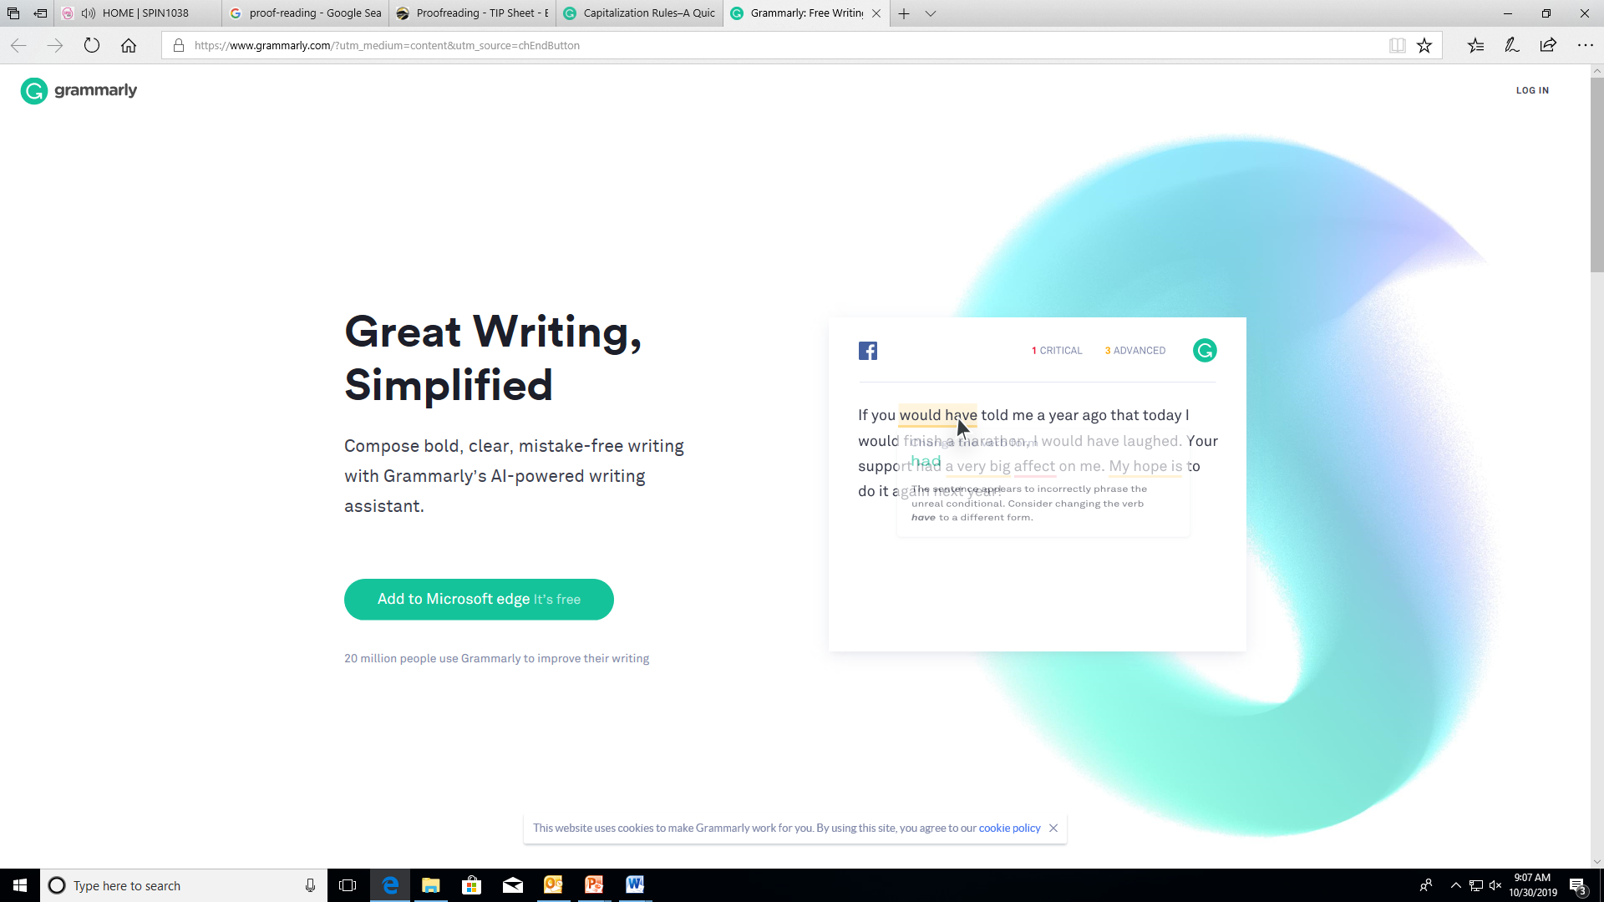
Notes:
Grammarly can help you correct grammar mistakes but don’t over rely on it!

Slide 23
Booking an appointment
List the free times in your timetable & send to:
  Email: learningdevelopment@iadt.ie
  Phone: 01 239 4790 or 0871023215
For example: My free times this week are; Mon, 9-11am and 12-1pm and Tues, 11am-1pm.

