Slide 1

Maintaining Motivation
Study Smart Workshop
Student Learning Centre

Slide 2

Welcome & thank you for coming
Objectives for this workshop;
What is motivation
What motivates you?
Tips to get yourself motivated

Slide 3
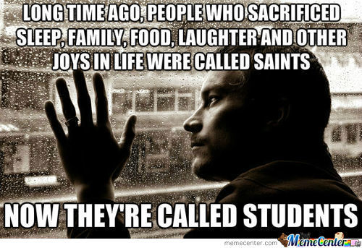
Who can relate?

Slide 4
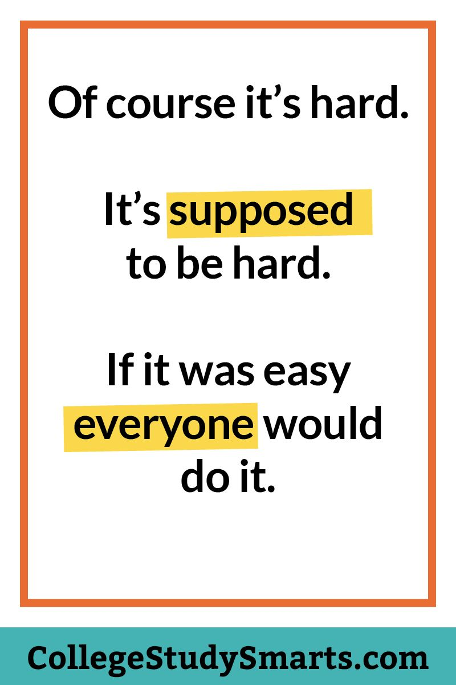

Slide 5
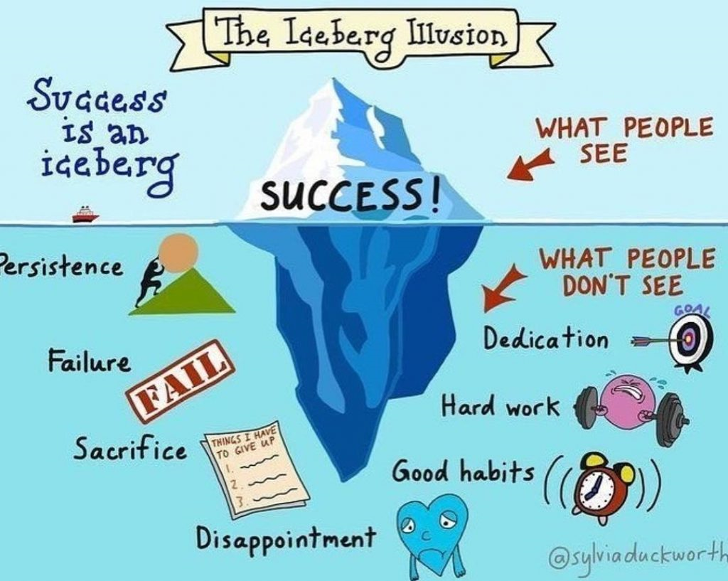

Slide 6
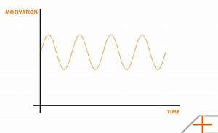
What is Motivation?
Motivation is what pushes us to achieve our goals, feel more fulfilled and improve our quality of life.
Self-motivation is the force that drives you to do things.
People who are self-motivated tend to be more organized, have goods time management skills and more self-esteem and confidence.
Understanding and developing your self-motivation can help you take control of many other aspects of your life.
Everyone’s motivation is different and it can fluctuate day to day!

Slide 7
What is Motivation?
There are two types of motivation: Intrinsic & Extrinsic motivation
Intrinsic motivation reflects the desire to do something because it is enjoyable and we are not worried about external rewards such as praise or awards etc. If we are intrinsically motivated the enjoyment we experience would be sufficient for us to want to perform the activity.
Extrinsic motivation reflects the desire to do something because of external rewards such as awards, money and praise. We may not enjoy certain activities but we can be motivated to do them to receive some external reward.

Slide 8
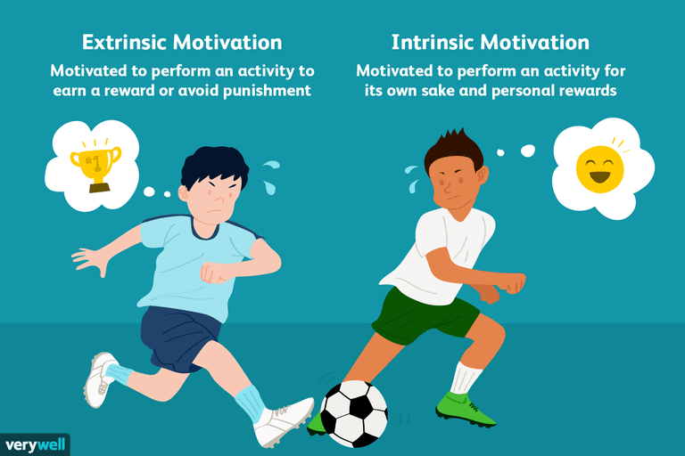

Slide 9
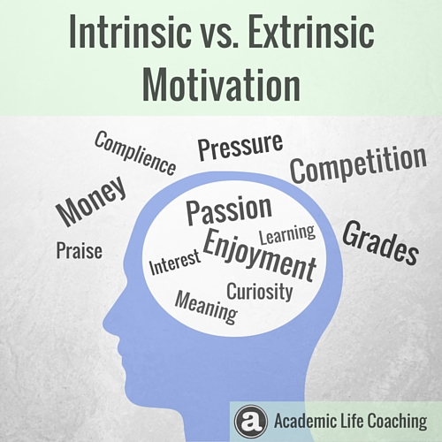

Slide 10

What motivates you?
Fundamental to self-motivation is understanding what motivates you
  Sounds simple?
  Let’s see…
What things are important to you?
What get’s in the way of you having those things?

Slide 11
Motivations, Goals & Achievement
The more people achieve= increased self-confidence= increased ability self-motivate and achieve.
Conversely, failure to achieve and meet goals= reduced self-esteem and self-confidence= reduced motivation to try achieve more.
Understanding this relationship between motivation, goals and achievements will help you set realistic personal goals, which in turn will allow you to achieve more in the long-term.
Personal goals can provide long-term direction and short-term motivation. Goals help us to focus!

Slide 12

Goal Setting
By setting clear, defined goals, you can measure your achievements and progress. If you fail to achieve the goal you can reassess your situation and try new approaches.
Keeping your goals clearly defined and updated is one of the most powerful ways to keep yourself motivated throughout life.
Tell someone about your goals too!! This will keep you accountable. Don’t forget to reward yourself when you achieve it.
Let’s set a SMART goal now!

Slide 13

The Importance of Obligation
What about a task that has neither intrinsic or extrinsic motivators??
Obligation motivators are not necessarily strictly intrinsic or extrinsic but can still be very powerful.
Obligation comes from our personal ethics and sense of duty, what is right and what is wrong.
Examples:
  You might feel obliged to go to a party because you were invited by a friend
  if you go to the party with an open and positive attitude this may add an intrinsic motivator of fun and enjoyment.

Slide 14

Pick out the Positives!
We all know it’s easier to get out of bed in the morning when we are facing ‘happier activities’ that day. Research shows that this is particularly important when we’re under stress.
It’s much easier to cope with stress and long hours if we enjoy what we do.
When thinking about tasks, try to identify what motivates you to do that task- think about both the intrinsic and extrinsic motivators.
If you are having trouble getting motivated write them down and list the motivators for each and what positives will come from the activity.

Slide 15
Task | Intrinsic Motivators | Extrinsic Motivators | Obligations | Positives?
Completing my assignment | Sense of achievement and accomplishment. | If I give it enough time, I can get a good grade. My lecturer will be really happy and I want to make a good impression | The assignment has to be done or I won’t pass the course | Reading will be interesting and an opportunity to learn
Going to the cinema on Friday | Get to spend time with my friend and I enjoy movies. |  |  | Spending time with friends makes me happy
Working a double shift |  | More money at the end of the month to go on a trip.

Slide 16

All about the balance in college!
Reward yourself with something you want after you complete something you need to do!!
Notes:
Examples:

Slide 17
Contact Details
List the free times in your timetable & send to:
  Email: learningdevelopment@iadt.ie
  Phone: 01 239 4790 or 0871023215
For example: My free times this week are; Mon, 9-11am and 12-1pm and Tues, 11am-1pm.

