Slide 1

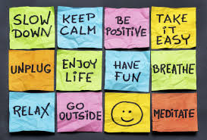
Learning about Stress
Joanna Gorniak & Aisling Hagerty
student Services

Slide 2
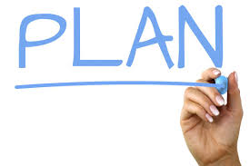
Plan for this session
  What is Stress and how does it affect us?
  The Symptoms of Stress
  The Stress Bucket
  Three helpful ways to manage stress

Slide 3

What is Stress?

Slide 4
Symptoms
Physical symptoms:
Aches and pains
Diarrhea or constipation
Nausea, dizziness
Chest pain, rapid heart rate
Loss of sex drive
Frequent colds or flu
Behavioral symptoms:
Eating more or less
Sleeping too much or too little
Withdrawing from others
Procrastinating or neglecting responsibilities
Using alcohol, cigarettes, or drugs to relax
Nervous habits (e.g. nail biting, pacing)

Slide 5
Symptoms of Stress
Cognitive symptoms:
Memory problems
Inability to concentrate
Poor judgment
Seeing only the negative
Anxious or racing thoughts
Constant worrying
Emotional symptoms:
Depression or general unhappiness
Anxiety and agitation
Moodiness, irritability, or anger
Feeling overwhelmed
Loneliness and isolation
Other mental or emotional health problems

Slide 6
Stress is Individual: ‘Stress Buckets’

Slide 7
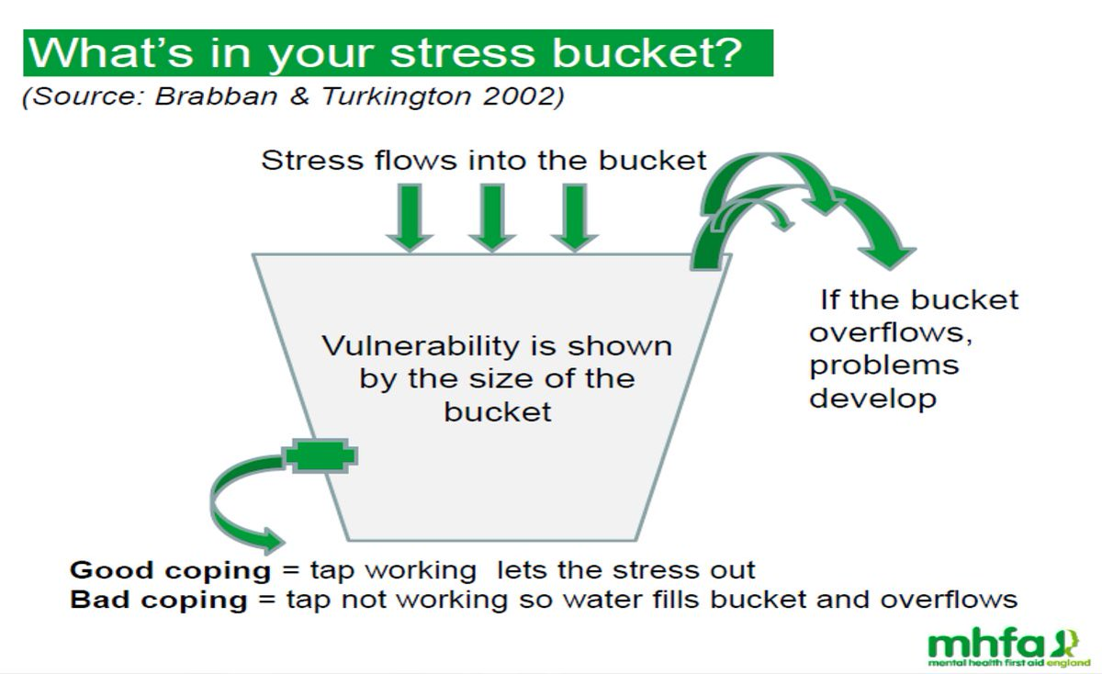
What fills your Stress Bucket?

Slide 8
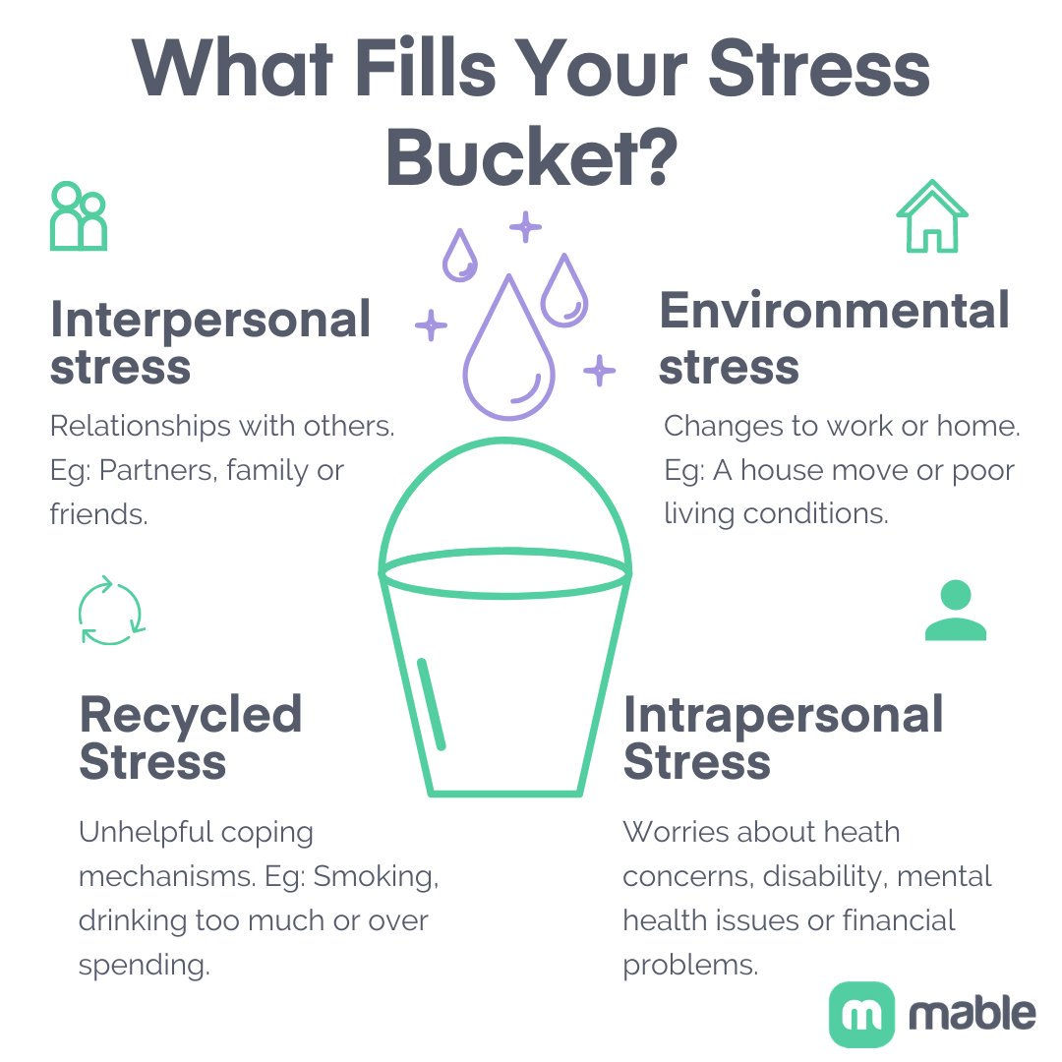

Slide 9
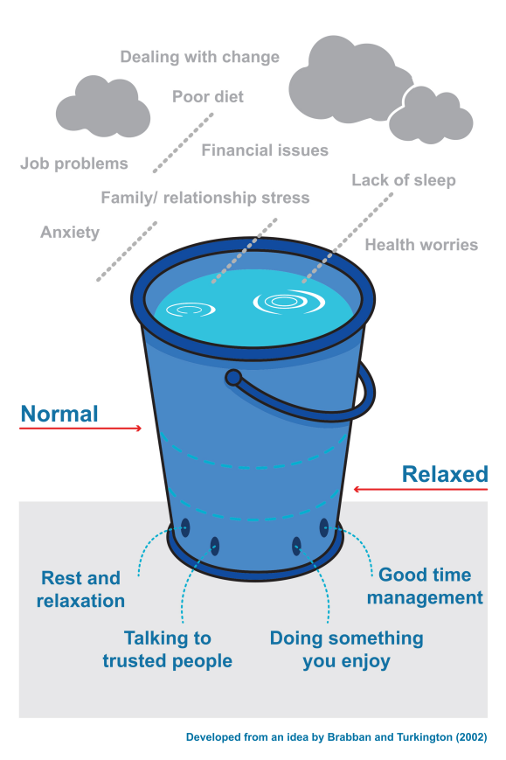
Developing a Wellness Toolbox
As we’ve learned stress can be inevitable (and both good & bad).
One of the best things we can do is try to build our resources to help keep us well and help us feel better during times of stress.
A wellness toolbox is one way to help!
This is a list of things you have done in the past, or could do, to help yourself stay well, and things you could do to help yourself feel better when you are not doing well.
Include things that you have done in the past, things that you have heard of and thought you might like to try, and things that have been recommended to you.

Slide 10
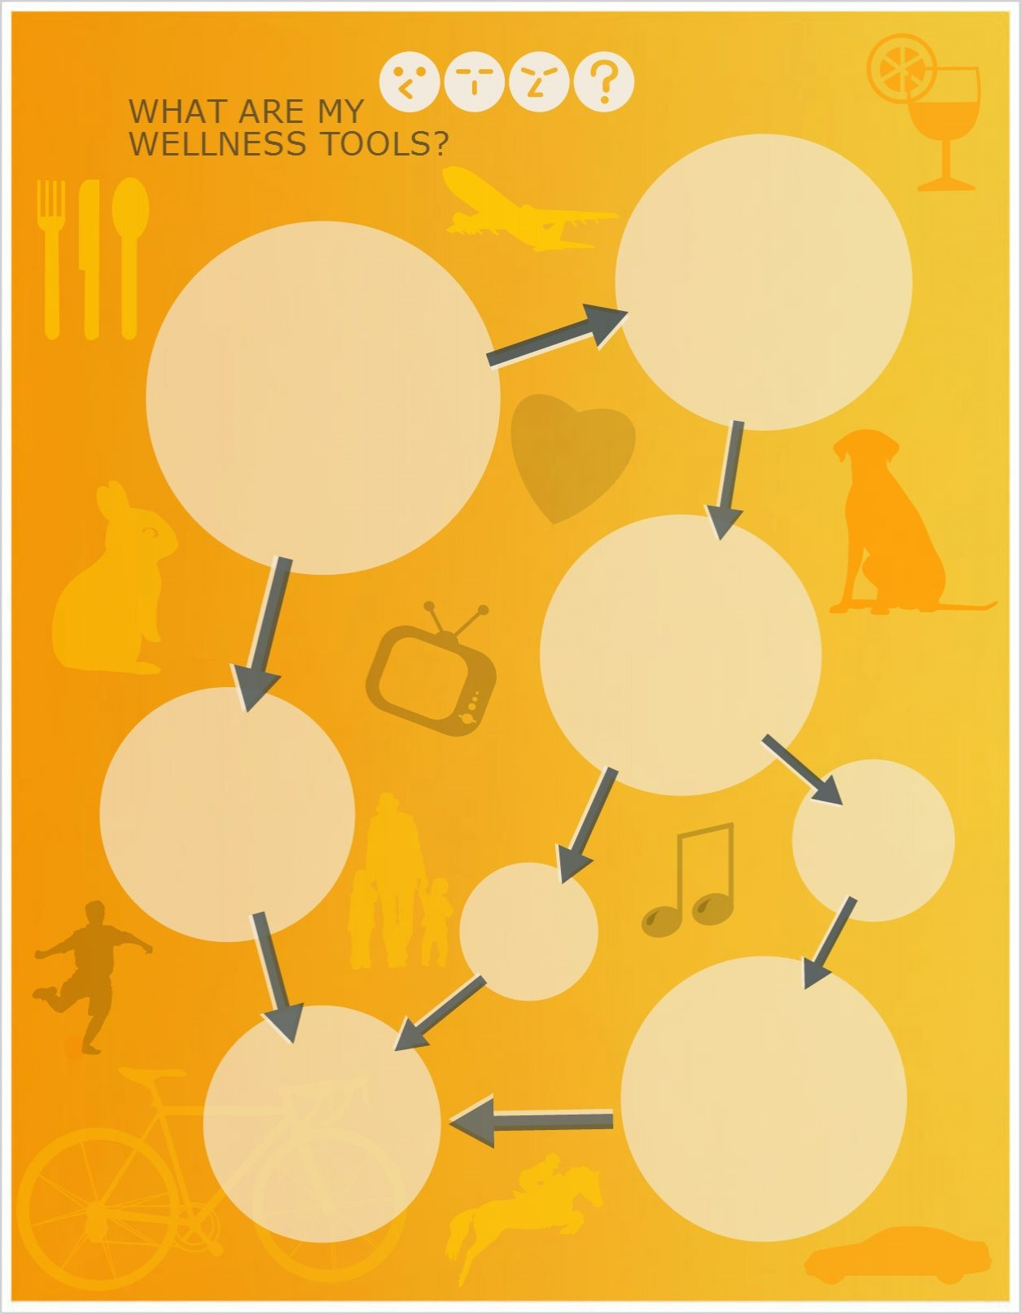


My Wellness Tools
Focusing on the present
Taking regular breaks
Positive self-talk
Talking to friends & family
Saying ‘No’
Exercise
Everyone’s will be different as they are personal to you!
Reality TV
Treating myself
Notes:
These are the things that I do to make me feel better and to keep me well.

Slide 11
Other Examples
Talk to a friend or a family member
Relaxation and stress reduction exercises
Guided imagery
Journaling–writing in a notebook
Creative activities like painting, singing, dancing, cooking
Exercise
Diet considerations
Extra rest
Take time off from home or work responsibilities
Take medications, vitamins, minerals, herbal supplements
Attend a support group
See your counsellor or a health care professional
Do something “normal” like washing your hair, showering or going to work
Get a medication check
Surround yourself with people who are positive, affirming and loving
Wear something that makes you feel good
Look through old pictures, scrapbooks and photo albums
Make a list of your accomplishments
Spend ten minutes writing down everything good you can think of about yourself
Do something that makes you laugh
Do something special for someone else
Get some little things done
Repeat positive affirmations
Focus on and appreciate what is happening right now
Take a warm bath
Listen to music, make music or sing

Slide 12
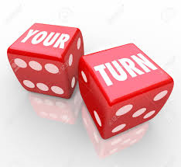
Now you can make yours
Let’s take 5-10 minutes to create your own Wellness Plan
* We can do this individually or in groups?

Slide 13
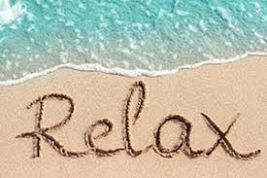
Progressive Muscle Relaxation
Tension is the body's natural response to threat, part of the body's alarm or survival mechanism. It can be a very useful response, but a lot of the time, we don't need this tension, so it's okay to learn to let it go, and learn some relaxation skills.
Learning to relax takes practice, as with learning any new skill.
Progressive Muscle Relaxation
Let’s Practice…

Slide 14
Practice
The track used is available on Youtube;
https://www.youtube.com/watch?v=wXUxiR6yQ_Q&t=144s

