Slide 1
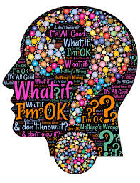

Learning about
Obsessive Compulsive Disorder (OCD)
Joanna Gorniak & Aisling Hagerty Student Services

Slide 2
Plan for this session
  What is Obsessive Compulsive Disorder
  How does it manifest
  Ways we can help ourselves or others

Slide 3
What is OCD?
OCD is a long-term mental health condition that is usually associated with two things: Obsessive thoughts and compulsive behaviours.
One of the most common mental health conditions in the world.
Obsessions: An unwanted, unpleasant thought, image or urge that repeatedly enters a person's mind. It's usually frightening or upsetting and, because they can't shake it, it makes them feel incredibly anxious.
We all experience such thoughts from time to time but for people who have OCD these thoughts consume their daily life.
Notes:
This can be thinking you may have forgotten to lock the door of the house. You can even have sudden unwelcome violent or offensive mental images. Many of these thoughts go away as quickly as they appear.

Slide 4
What is OCD?
Some common obsessions include a fear of harming themselves or others either deliberately or by mistake, the fear of contamination by disease or germs and even the need for everything to be in perfect order.
Compulsions: These are the repetitive behaviours or mental acts that a person feels compelled to perform to try to avoid or undo the effect of the obsession.
Most people are aware that their behaviour is unrealistic or out of control but can't stop acting on the compulsion.

Slide 5
What is OCD?
Common types of compulsive behaviour include:
Excessive cleaning and hand washing
Checking - such as checking doors are locked or that switches and appliance are off
Counting and doing the same thing many times
Ordering and arranging
Hoarding
Asking for reassurance
Repeating words in their head
Thinking 'neutralising' thoughts to counter the obsessive thoughts
Avoiding places and situations that could trigger obsessive thoughts

Slide 6
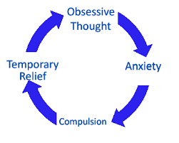
The Cycle of OCD
Notes:
Step One - Obsession: This is when the obsessive thought kicks in and ovewhelms your mind.
Step Two - Anxiety: You become anxious or worried as a result of the obsessive thought.
Step Three - Compulsion: You adopt a pattern of compulsive behaviour to reduce your anxiety and distress. Someone who is unnaturally worried that their house will be burgled might repeatedly check that their door is locked at least three times before leaving. A person with obsessive thoughts about germs may wash their hands repeatedly.
Some other common types of compulsive behaviour that affect people with OCD include cleaning, counting, ordering and arranging, hoarding, asking for reassurance, needing to confess, repeating words silently, prolonged thoughts about the same subject and 'neutralising' thoughts (to counter the obsessional thoughts or images).
Step Four - Temporary Relief: The complusive behaviour allows the person with OCD to take a bit of a breather as the anxiety dies down. However, it will come back and the cycle begins again.

Slide 7
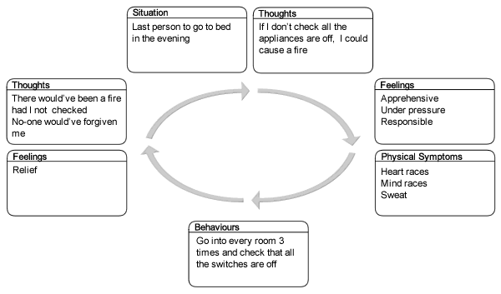
Example:
Notes:
This is an example of how our thoughts, feelings and behaviours can interact and influence one another.

Slide 8
Contributing Factors
OCD doesn't discriminate and there is no single, proven cause of OCD.
Can sometimes run in families, although no specific genes have been linked to it. Childhood-onset OCD tends to run in families. When a parent has OCD, there is a slightly increased risk that a child will develop OCD. It is the general nature of OCD that seems to be inherited, not specific symptoms.
Stress alone isn't thought to cause OCD but a particularly stressful or upsetting life event may trigger the condition in someone who already has a tendency for it.
The chemical serotonin also seems to play a part in OCD.
  It's a neurotransmitter, which is a chemical that the brain uses to transmit information from one brain cell to another. Experts still aren't sure exactly what role it plays but medications that increase the serotonin levels in the brain, such as certain antidepressants, have successfully helped to treat the symptoms of OCD.
Notes:
No specific genes for OCD have yet been identified, but research suggests that genes do play a role in the development of the disorder in some cases. Childhood-onset OCD tends to run in families (sometimes in association with tic disorders). When a parent has OCD, there is a slightly increased risk that a child will develop OCD, although the risk is still low. When OCD runs in families, it is the general nature of OCD that seems to be inherited, not specific symptoms. Thus a child may have checking rituals, while his mother washes compulsively.

Slide 9

Available Supports
The two main treatments types are:
  Psychological therapy - helps you understand OCD and learn new ways of coping. Can include Cognitive Behavioural Therapy and Exposure- Response Prevention Therapy.
  Medication - usually an antidepressant, changes the balance of chemicals in your brain.
Support groups for people with OCD are also available through OCD Ireland. These run bi-weekly in St Patricks Mental Health Services. They also provide a series of lectures about OCD, Trichotillomania and Body Dysmorphic Disorder. Runs monthly in St. Patrick’s Hospital in Dublin and no booking required.
Notes:
Cognitive Behavioural Therapy (CBT) helps you manage your problems by thinking more positively. It frees you from unhelpful patterns of behaviour.
Exposure and Response Prevention (ERP) is a type of CBT that is used to treat OCD.
You learn to understand the triggers for your thoughts and behaviours.
It allows the obsessive thoughts occur without neutralising them with compulsive behaviours. This is called graded exposure.
You start with situations that cause you the least anxiety first. You do this before moving onto more difficult thoughts.
The treatment can be difficult and may sound frightening, but people do get better.

Slide 10
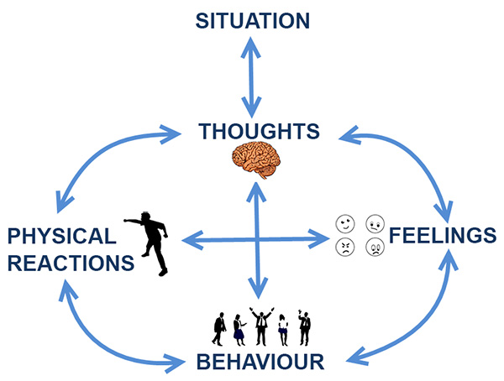
CBT exercises
Notes:
Cognitive Behavioural Therapy focuses on changing our thoughts to more balanced thoughts so that people with OCD do not feel the need to engage in compulsions.

Slide 11
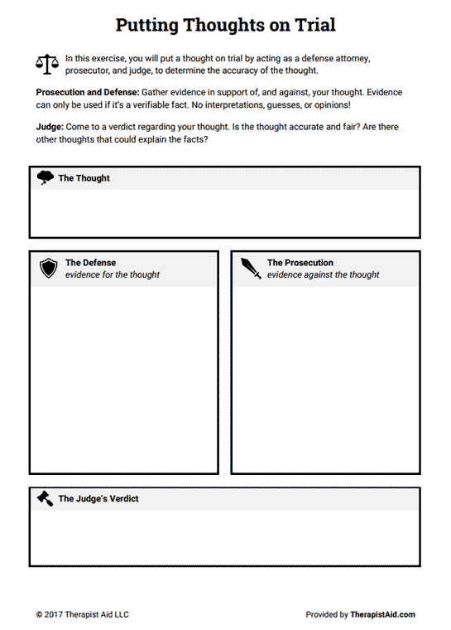
Notes:
One way to challenge negative thoughts is the technique of ‘putting thoughts on trial’. Identify the thought, what supports the thought and what goes against it and suggests that it is not true. After you have looked at both sides you can decide on the verdict (this should be more balanced than your original thought)

Slide 12
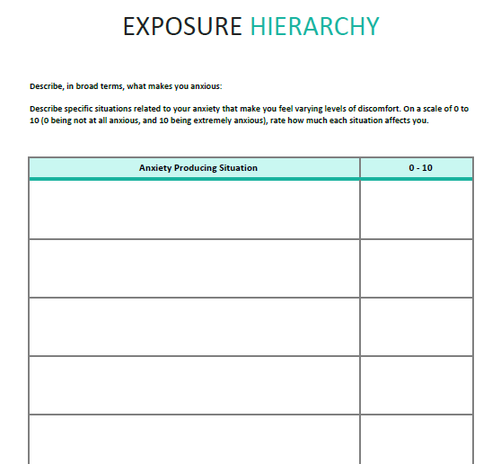
Notes:
Exposure therapy also looks at creating an exposure hierarchy. This helps people gain mastery and complete tasks without engaging in compulsions. The hierarchy starts with smaller goals and then builds the person up to face more challenging situations. The person is asked to rate how anxiety provoking each task is. The situation that produces the least anxiety is the first place to start.

Slide 13

Supporting someone with OCD
Do keep an eye out for strange behaviour. Sometimes the person will try to hide their compulsive rituals and mental rituals are harder to recognise. The effects of physical rituals can be that bit easier: Someone who washes their hands a lot may have very dry skin.
Do help them to seek treatment and support them as they go through the process of recovery.

Slide 14
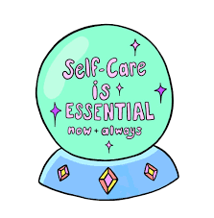
Supporting someone with OCD
Don't be tempted to try and carry out some of the rituals for them. For example, if they need to check doors and windows three times, don't offer to do the third round for them. It's natural to want to protect someone we care about but taking on their fears won't help them solve the issue and move on.
Don't take it all upon yourself either. When someone with OCD decides to get help, a good GP will be able to recognise the signs and get further support from specialists. These professionals can also help you to support your friend or family member.

Slide 15
Useful Resources
https://spunout.ie/health/article/obsessive-compulsive-disorder?gclid=EAIaIQobChMIvN2_l4W_5wIVy7HtCh0fNAXlEAAYASAAEgJkfPD_BwE
https://www2.hse.ie/conditions/mental-health/obsessive-compulsive-disorder/obsessive-compulsive-disorder-ocd-symptoms.html
https://www.ocdireland.org/

