Slide 1
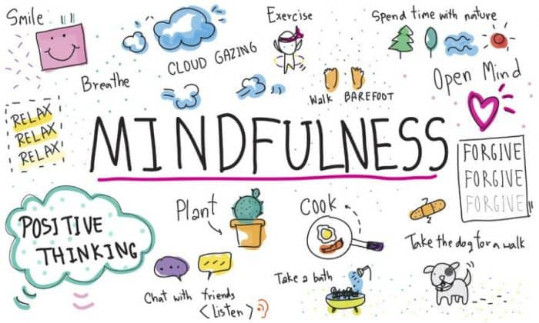

Learning about Mindfulness
Joanna Gorniak & Aisling Hagerty Student Services

Slide 2
Plan for this session
  What is Mindfulness
  Benefits of Mindfulness
  Ways to incorporate mindfulness into your daily routine

Slide 3
What is Mindfulness?
  Simple concept but can be difficult- We are not used to it and it can take a lot of practice.
  Practical way to notice thoughts, physical sensations, sights, sounds, smells- anything we might not normally notice.
  Paying attention in a particular way
    On purpose
    In the present moment
    Non-judgementally

Slide 4
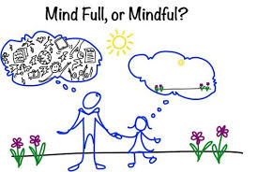
Notes:
There is a big difference between having a full mind and being mindful! Mindfulness isn’t thinking about lots of things and is instead about being more aware of what you are thinking about.

Slide 5
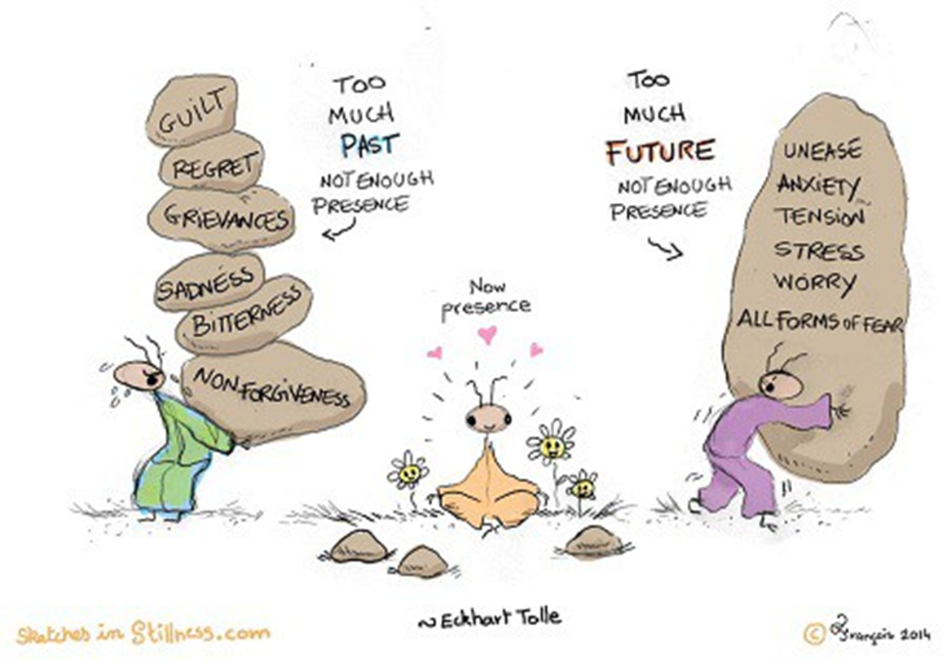
What is Mindfulness?
  Our mind wanders about 50% of the time
  Mindfulness helps us train our attention
    Can take more control over our focus of attention and choose what we focus on.
    Experiences can be viewed as a wider perspective as passing events in the mind rather than as ‘us’ or as being necessarily true.

Slide 6
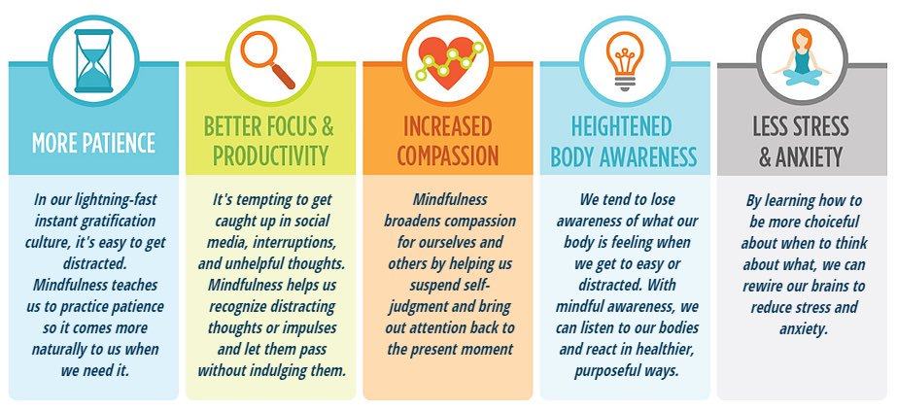
Benefits of Mindfulness

Slide 7
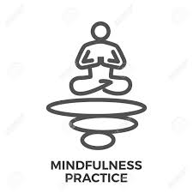
Practice Exercise
Notes:
Put a timer on your phone for one minute. Sit on a chair comfortably and simply breathe in and out. Notice what happens in your body. Notice your feet on the floor and the things around you. If you notice your mind wandering gently bring it back to the present moment.

Slide 8
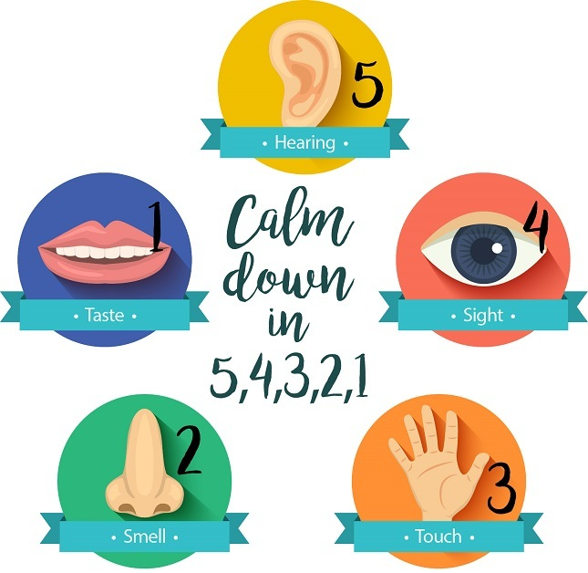
Practice Exercise
Notes:
Another way to practice mindfulness is to name 5 things you can hear, 4 things you can see, 3 things you can touch or feel, 2 things you can smell and one thing you can taste. If you are finding it difficult to smell or taste things think of things you like to smell or taste. This can be done in any order too. This is helpful way to settle your mind when feeling anxious and helps bring you back to the present moment.

Slide 9
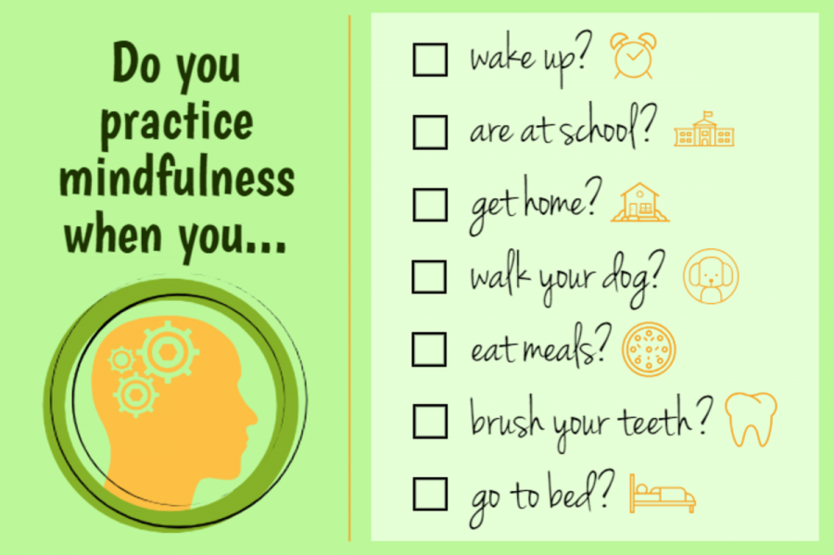
Mindfulness Practice in your daily routine
Notes:
Ask yourself the following questions and think of other activities that you do or don’t do mindfully.

Slide 10
Useful Resources
Websites
  https://www.padraigomorain.com/mindfulness-for-students/
  https://www.mindful.org/take-a-mindful-moment-5-simple-practices-for-daily-life/
  https://www.getselfhelp.co.uk/
  https://zenhabits.net/
Headspace Smartphone App
Youtube
Spotify

Slide 11
