Slide 1

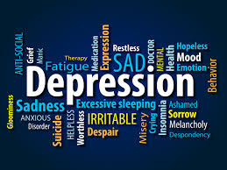
Learning about
Depression
Aisling Hagerty & Joanna Gorniak
Student Services

Slide 2

Plan for this session
  What is Depression?
  How can we recognize it?
  How can we help ourselves & others?

Slide 3
What is Depression?
  Nearly everyone has felt depressed, sad, or down in the dumps at one time or another.
  Feeling depressed can be a normal reaction to a stressful event, such as when one suffers a loss or endures another of life’s various struggles or stresses. Typically after time our mood begins to lift and we can move on.
  Depression is a serious medical condition that affects your behaviour, your thinking, your emotions and physical health over time.
  While feeling down only lasts for a short while, depression affects you for at least 2 weeks and affects your everyday life and ability to function.
  It can vary from mild to severe and can have a profound impact, affecting every aspect of the individual, their relationships, family and work life.

Slide 4
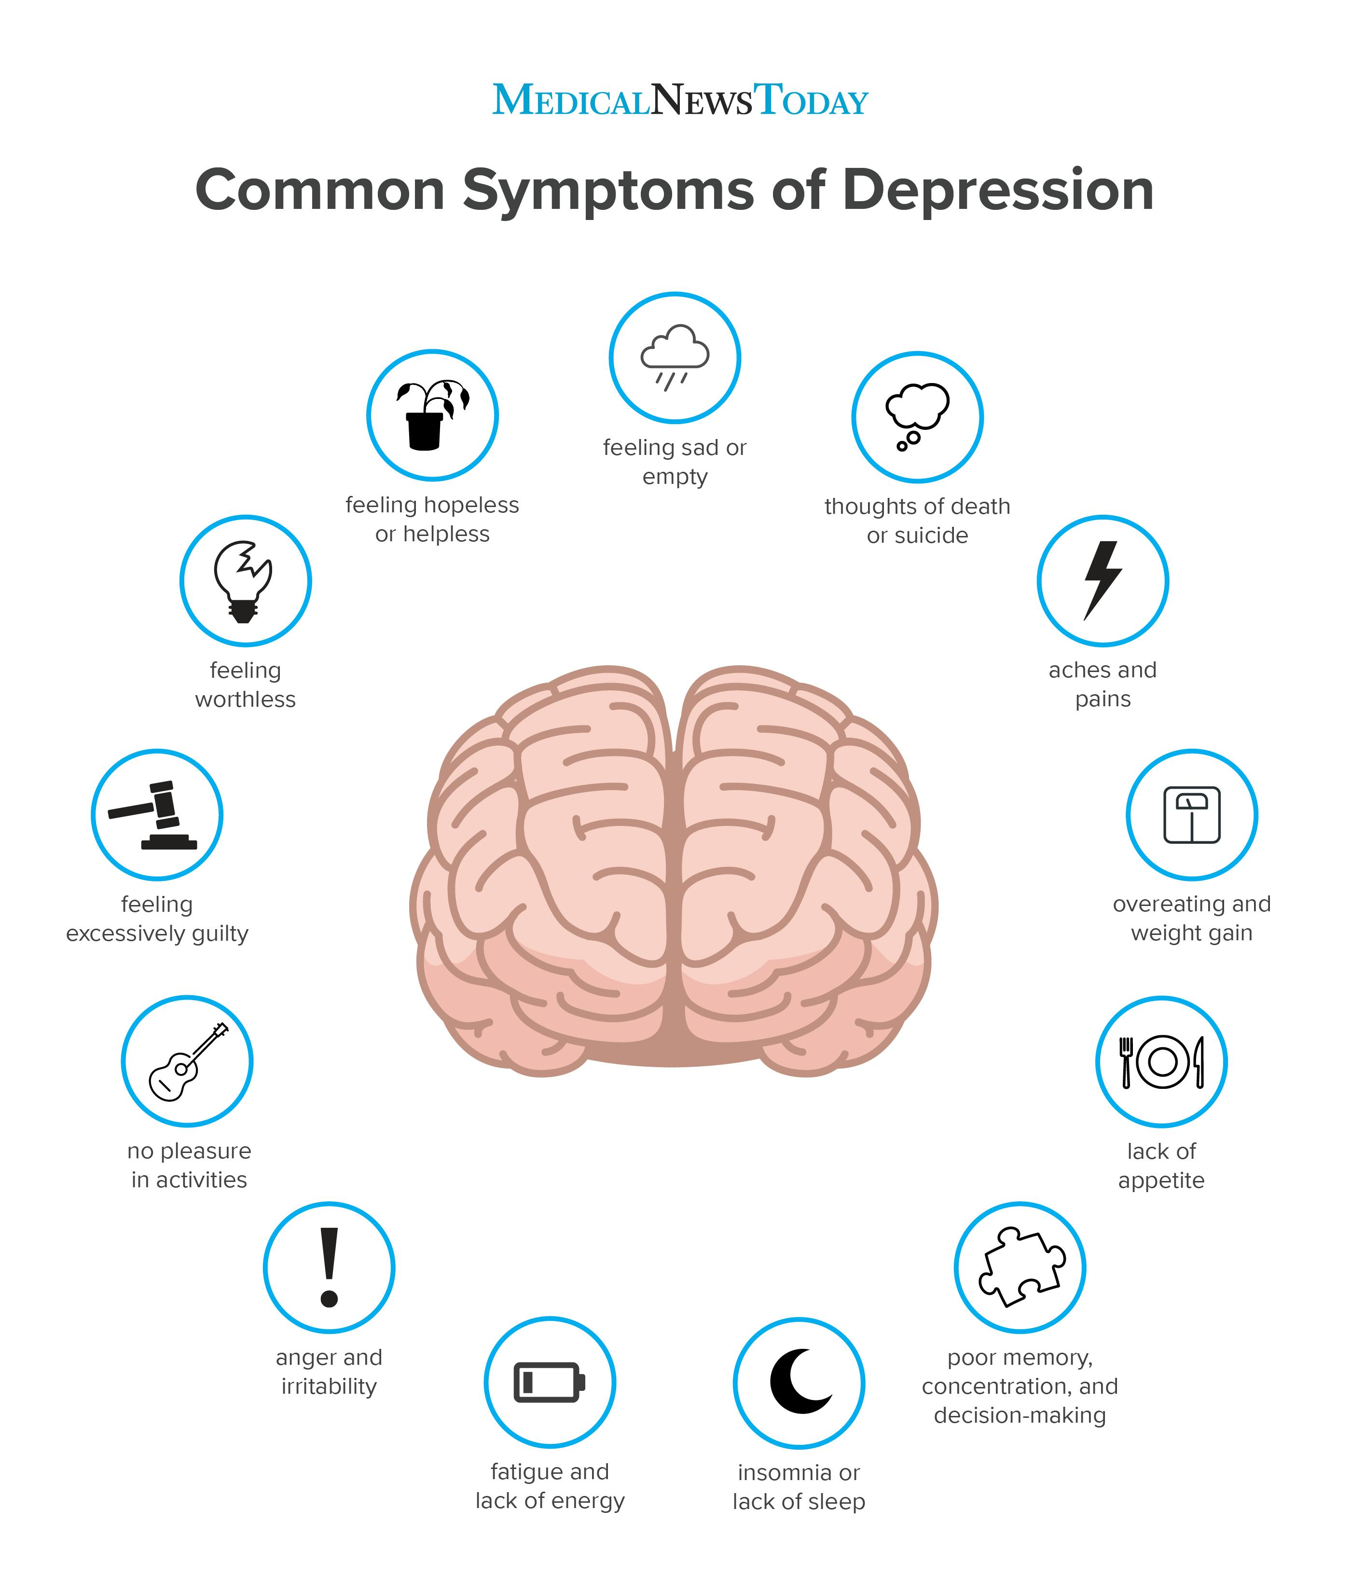

Slide 5
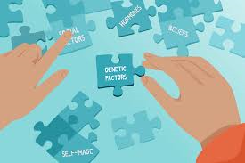
Causes of Depression
There are a lot of different causes of depression.
These can include:
A build-up of stress and anxiety from being bullied, working too hard or family situations.
Alcohol and drug abuse can cause depression.
Grief or serious life changes, such as when someone dies, you become sick, lose your job or have an accident.
Depression often runs in families and you might inherit the genes that make it more likely to have depression. However, if a family member suffers from depression, it doesn’t mean that you will as well.

Slide 6
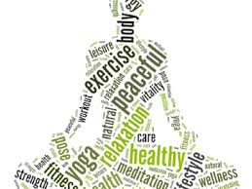
Tips to Help you Cope
Be aware of your thoughts and challenge unhelpful thinking
Maintain a balanced lifestyle
Seeking Support

Slide 7






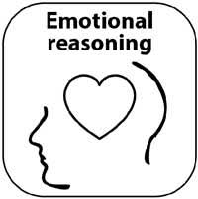

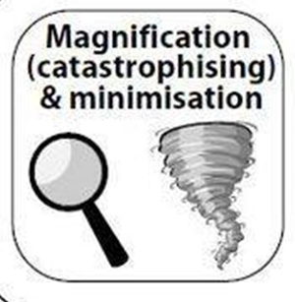
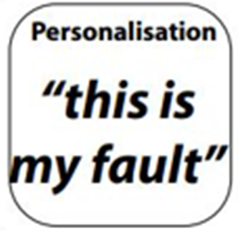
Challenge Unhelpful Thinking
We can all be prone to ‘distorted thinking’ at times.
When we are stressed our ‘distorted thinking’ or ‘unhelpful thinking styles’ become more exaggerated. This is something that happens outside our awareness and can become an automatic habit.
Examples (see handout):

Slide 8
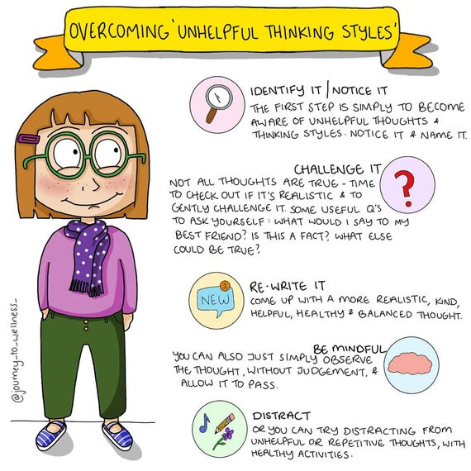

Slide 9
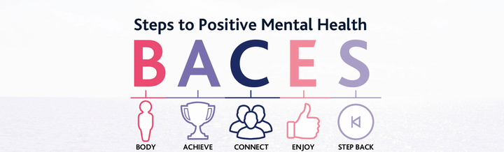
Maintaining Healthy Lifestyles

Slide 10

Let’s look at how you incorporate these into your life?
Notes:
Take out the BACE template and think about the ways in which you are looking after yourself under each of the headings.

Slide 11
Additional Tips
Exercise can be very beneficial. Exercise releases endorphins in your body which are known to improve your mood
As sleep is often impacted when mood is low, it is helpful to consider what aids your sleep.
  Try not to drink tea and coffee late at night as they are stimulants.
  Consider leaving your electronic devices out of your bedroom. It is helpful to prepare for sleep
Try to eat a balanced and nutritious diet. A healthy diet produces a healthy body and a healthy mind
Alcohol is a depressant and can be a potent trigger to low mood, especially in individuals prone to depression. It can also interact dangerously with some medication

Slide 12
Additional Tips
Try to focus on what is going well in your life. Even on a bad day, there are good moments in it. Consider keeping a gratitude diary and noting three good things that happen each day.
  You might find it useful to write down three things you achieved at the end of each day. This can contribute towards building your self-esteem and generating more positive thoughts.
Above all, do not try to deal with depression on your own. Reach out to family and friends, and use the help and support that is available to you.

Slide 13
Seeking Support
If you think you're suffering from depression, the first thing to do is talk to someone. You can share your concerns with family and friends and it is also a good idea to talk to a professional also e.g. GP, Student Counsellor, external counselling or psychological services
Helpful Websites
  www.grow.ie
  www.spunout.ie
  www.aware.ie

Slide 14
Seeking Support
Jigsaw - a free counselling and mental health service for young people. You can find details on your local Jigsaw here.
Samaritans - a free, confidential listening service. You can contact them on 116 123.
Childline - a free, confidential listening services for people under 18. You can contact them on 1800 666 666.
Traveller Counselling Service - a free counselling service for Travellers going through any sort of difficulty. You can contact them on 086 308 1476.

