Slide 1

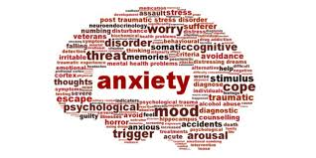
Learning about Anxiety
Aisling Hagerty & Joanna Gorniak
Student Services

Slide 2

Plan for this session
  What is Anxiety?
  The Vicious Cycle of Anxiety
  Helpful ways to manage Anxiety

Slide 3
What is Anxiety?
Anxiety is a feeling of unease, such as worry or fear, that can be mild or severe.
We all feel anxious some times. Anxiety is completely normal!
A certain amount of anxiety helps us to be more alert and focused.
  For example just prior to an exam, a few exam nerves have a positive effect - motivating us, helping us focus our thoughts on the job in hand, making us more alert. In this instance anxiety is a good thing as it helps you keep motivated.
  Too much anxiety, or constantly being anxious, is unhealthy and detrimental to our lives and relationships.

Slide 4
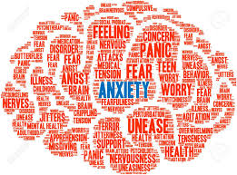
Types of Anxiety
In all anxiety, we tend to over-estimate the danger, and under-estimate our ability to cope.
Different types include:
  Generalised anxiety disorder (GAD)
  Social anxiety
  Specific phobias
  Panic disorder
  Agoraphobia
  Obsessive compulsive disorder (OCD)
  Post-traumatic stress disorder (PTSD)
Notes:
GAD is the most common type of anxiety disorder. The main symptom of GAD is over worrying about different activities and events. This may feel out of your control. You feel anxious a lot of the time if you have GAD. You might feel ‘on edge’ and alert to your surroundings. GAD can be difficult to diagnose because it does not have some of the unique symptoms of other anxiety disorders. Your doctor is likely to say you have GAD if you have felt anxious for most days over six months and it has had a bad impact on areas of your life.
Panic disorder results in regular panic attacks with not particular trigger. They can happen suddenly and feel intense and frightening, it is also possible to dissociate during panic attacks. You may also worry about having another panic attack.
Social anxiety disorder is sometimes known as social phobia. Lots of people worry about social situations but if you have social anxiety you will have an intense fear or dread of social or performance situations. This can happen before, during or after the event. You may be worried that you will do something or act in a way that is embarrassing. You might feel aware of the physical signs of your anxiety.
A phobia is an overwhelming fear of an object, place, situation, feeling or animal.
Phobias are stronger than fears. They develop when a person has increased feelings of danger about a situation or object. Someone with a phobia may arrange their daily routine to avoid the thing that’s causing them anxiety.
Agoraphobia is a fear of being in situations where escape might be difficult. Or situations where help wouldn’t be available if things go wrong. This could be:
Leaving your home
Being in public spaces
Using public transport
Being in crowded spaces
You might find that these situations make you feel distressed, panicked and anxious. You may avoid some situations altogether. This can affect day-to-day life.
You will have obsessions, compulsion or both if you have OCD.
An obsession is an unwelcome thought or image that you keep thinking about and is largely out of your control. These can be difficult to ignore. These thoughts can be disturbing, which can make you feel distressed and anxious.
Compulsion is something you think about or do repeatedly to relieve anxiety. This can be hidden or obvious. Such as saying a phrase in your head to calm yourself. Or checking that the front door is locked.
You have PTSD if your anxiety symptoms were caused by a threatening life situation, such as a train crash or fire. You can feel anxious for months or years after the event even if you weren’t physically harmed at the time.

Slide 5
Anxiety
Anxiety Behaviours
  Avoiding people or places
  Not going out
  Going to certain places at certain times, e.g. shopping at smaller shops, at less busy times
  Only going with someone else
  Escape, leave early
Safety Behaviours: Go to the feared situation, but use coping behaviours to get you through, such as: holding a drink, smoking more, fiddling with clothes or handbag, avoiding eye contact with others, having an escape plan, taking medication.
Safety behaviours can also help to keep your anxiety going.
Notes:
Whilst avoiding people or situations might help you feel better at that time, it doesn't make your anxiety any better over a longer period. If you're frightened that your anxiety will make you pass out or vomit in the supermarket aisle, you won't find out that won't actually happen, because you don't go. So the belief that it will happen remains, along with the anxiety.

Slide 6
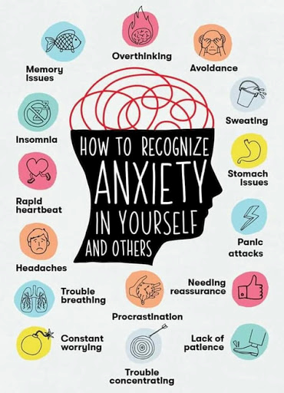
Notes:
These are some of the common symptoms you might notice in yourself and/or others.

Slide 7
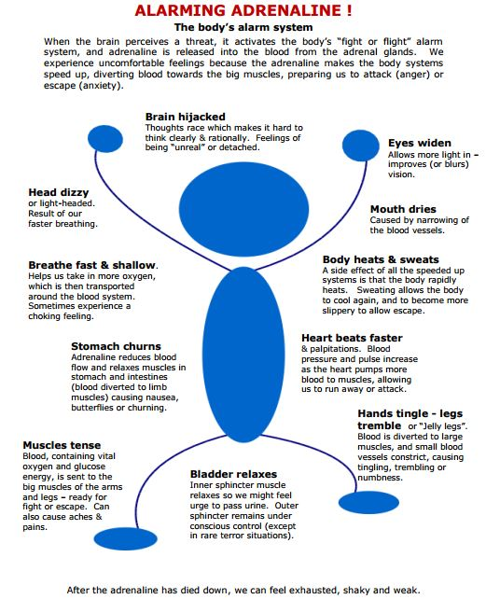
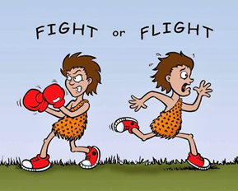
Notes:
Anxiety is the body's way of responding to being in danger. Adrenaline is rushed into our bloodstream to enable us to run away or fight. This happens whether the danger is real, or whether we believe the danger is there when actually there is none. It is the body's alarm and survival mechanism. Primitive man wouldn't have survived for long without this life-saving response. It works so well, that it often kicks in when it's not needed - when the danger is in our heads rather than in reality. We think we're in danger, so that's enough to trigger the system to go, go, go! People who get anxious tend to get into scanning mode - where they're constantly on the lookout for danger, hyper-alert to any of the signals, and make it more likely that the alarm system will be activated.

Slide 8
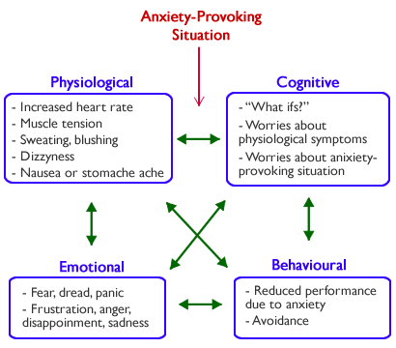
The Vicious Cycle of Anxiety
Notes:
Each part of the cycle interacts with each other and can impact our thoughts, feelings and behaviors.

Slide 9
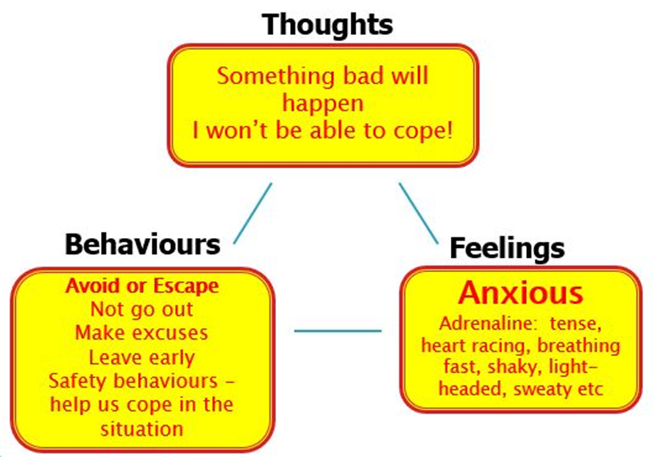
Notes:
Our negative thoughts such as ‘I wont be able to cope’ leads to increased feelings of anxiety and makes us more likely to want to avoid going places. We need to intervene at any part of the cycle (i.e. thoughts, feelings, behaviours) in order to break the cycle.

Slide 10
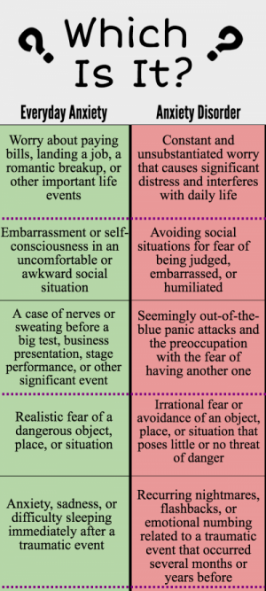
Notes:
As we mentioned, everyone can relate to the feeling of anxiety however it is important to recognize when anxiety becomes a problem for you or a loved one.

Slide 11
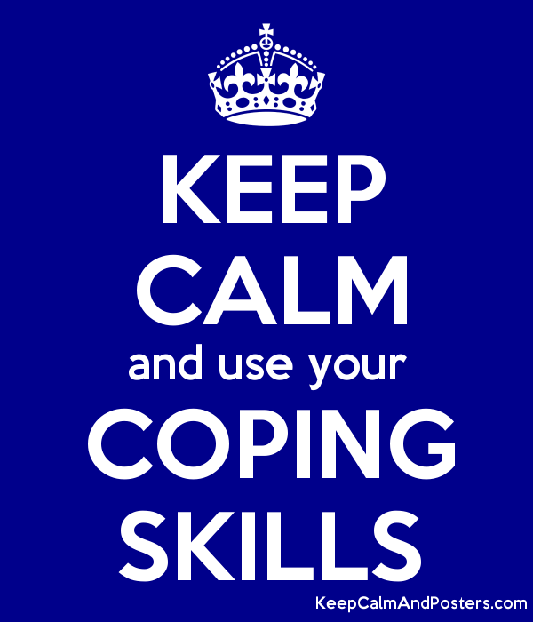
Tips to Help you Cope
Remember Anxiety is something we all experience to varying degrees and is something you can learn to cope with once you have the correct skills.
These can include;
  Challenging Unhelpful Thinking
  Breathing
  Using APPLE

Slide 12

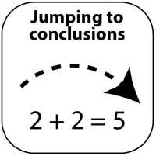




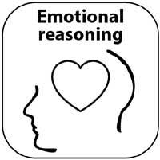
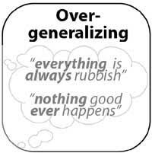
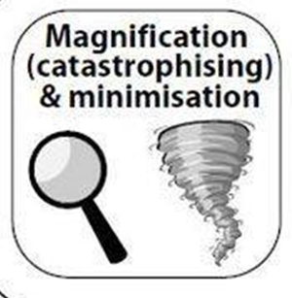

Challenge Unhelpful Thinking
We can all be prone to ‘distorted thinking’ at times.
When we are stressed our ‘distorted thinking’ or ‘unhelpful thinking styles’ become more exaggerated. This is something that happens outside our awareness and can become an automatic habit.
Examples (see handout):

Slide 13
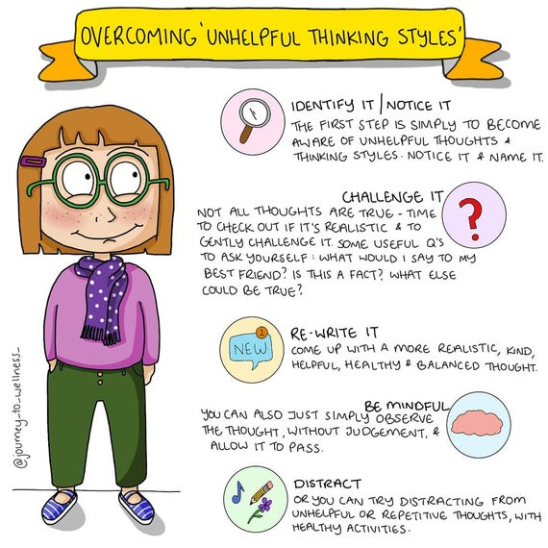

Slide 14
Breathing
Breathing exercises take only a few seconds, no matter where you are.
It is particularly helpful at stressful times, and also practise it at regular intervals throughout the day.
When learning the technique it is a good idea to try it when you are feeling calm. NB: Need to take time to learn the skill before you can use it when stressed.

Slide 15
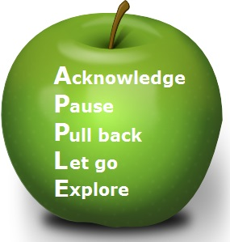
ACKNOWLEDGE - Notice and acknowledge the uncertainty as it comes to mind.
PAUSE - Don't react as you normally do. Don't react at all. Just pause, and breathe.
PULL BACK - Tell yourself this is just the anxiety or depression talking, and this thought or feeling is only a thought or feeling. Don't believe everything you think! Thoughts are not statements of fact.
Notes:
ACKNOWLEDGE - Notice and acknowledge the uncertainty as it comes to mind.
PAUSE - Don't react as you normally do. Don't react at all. Just pause, and breathe.
PULL BACK - Tell yourself this is just the anxiety or depression talking, and this thought or feeling is only a thought or feeling. Don't believe everything you think! Thoughts are not statements of fact.
LET GO - Let go of the thought or feeling. It will pass. You don't have to respond to them. You might imagine them floating away in a bubble or cloud.
EXPLORE - Explore the present moment, because right now, in this moment, all is well. Notice your breathing, and the sensations of breathing. Notice the ground beneath you. Look around and notice what you see, what you hear, what you can touch, what you can smell. Right NOW. Then, SHIFT YOUR FOCUS OF ATTENTION to something else - on what you need to do, on what you were doing before you noticed the worry, or do something else - mindfully, with your full attention.

Slide 16
LET GO - Let go of the thought or feeling. It will pass. You don't have to respond to them. You might imagine them floating away in a bubble or cloud.
EXPLORE - Explore the present moment, because right now, in this moment, all is well. Notice your breathing, and the sensations of breathing. Notice the ground beneath you. Look around and notice what you see, what you hear, what you can touch, what you can smell. Right NOW. Then, SHIFT YOUR FOCUS OF ATTENTION to something else - on what you need to do, on what you were doing before you noticed the worry, or do something else - mindfully, with your full attention.
Notes:
ACKNOWLEDGE - Notice and acknowledge the uncertainty as it comes to mind.
PAUSE - Don't react as you normally do. Don't react at all. Just pause, and breathe.
PULL BACK - Tell yourself this is just the anxiety or depression talking, and this thought or feeling is only a thought or feeling. Don't believe everything you think! Thoughts are not statements of fact.
LET GO - Let go of the thought or feeling. It will pass. You don't have to respond to them. You might imagine them floating away in a bubble or cloud.
EXPLORE - Explore the present moment, because right now, in this moment, all is well. Notice your breathing, and the sensations of breathing. Notice the ground beneath you. Look around and notice what you see, what you hear, what you can touch, what you can smell. Right NOW. Then, SHIFT YOUR FOCUS OF ATTENTION to something else - on what you need to do, on what you were doing before you noticed the worry, or do something else - mindfully, with your full attention.

Slide 17
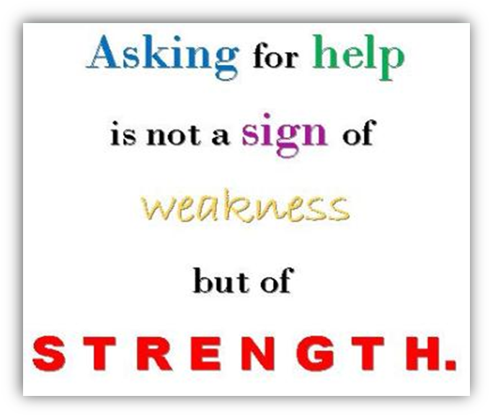
Seeking Support
If you feel anxious all the time, for several weeks or if it feels like your anxiety is taking over your life, then it’s a good idea to ask for help. Your GP should be your first point of contact. If in distress or out of office hours you can contact the A&E dept. of your local hospital.
Helpful Contacts;
  Samaritans Ireland; FreePhone: 116 123 jo@samaritans.org www.samaritans.org
  Your Mental Health www.yourmentalhealth.ie
  Social Anxiety Ireland 01 803 2919 www.socialanxietyireland.com
  Mental Help www.mentalhelp.ie
Notes:
There are a number of professional supports available to help you manage your anxiety. In college the student counselling service is available to all students and appointments can be made online at studentcounselling@iadt.ie. The Student Learning Centre and Disability Office are also available to support students who may feel anxious about their workload, presentations etc.

Slide 18
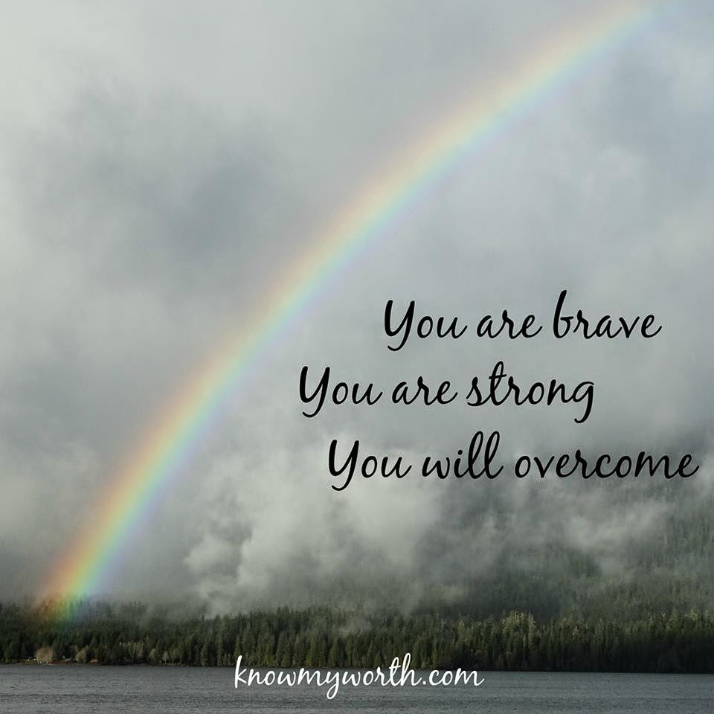
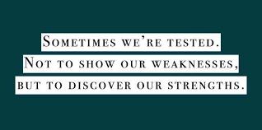
Remember…
Notes:
Remember Anxiety is something you can overcome and learn to cope with. Anxiety is an important factor in our lives and can help us to some degrees e.g. keeps us safe and keeps us focused and motivated in college. The important skill to learn is how to stay in control and you will be able to do this by challenging your thinking to create more balanced thoughts, using the APPLE technique and focusing on your breathing.

