Slide 1

Essay Writing
Study Smart Workshop
Student Learning Centre

Slide 2

Welcome & thank you for coming
Objectives for this workshop;
  Components of an essay
  Planning an essay
  Formatting
  Tips to help you
  Key points to remember

Slide 3

Preliminary Planning
1. Read the assignment brief
2. Choose a topic
3. Formulate research questions/ideas
4. Make a thesis statement/ argument
5. Plan your time
Notes:
Read the assignment brief. Read the exact words of the assignment very closely and be absolutely sure of what is required. If you’re not certain, don’t be afraid to ask for help.
Choose a topic. What is it that you want to know? What do you find interesting? What do you think you might have something to talk about? Take your time and think about it — a little extra effort and time now might save you a lot later in the process. You don’t need to be specific right now — a general area will be enough to begin your work. It may be worth thinking of multiple options just in case.
Formulate research questions what do you want to know? What interests you about the topic? What questions have not yet been answered? Bring in your own knowledge and personal experience. These questions will guide you through all your planning and writing.
Make a thesis statement. It should be something you can prove or disprove It should be the right level of complexity to fit the scope and word count of your assignment When you start writing, make sure every paragraph you write has something to do with the thesis.
Plan your time. Break down each task into sub-tasks — in fact, break everything down as much as you need to — and plan time for each step. Make sure to include extra time in case anything goes wrong. The more work you put into planning, the easier the actual writing will be.

Slide 4

Pre-writing
Research & find sources of information
Read enough material in order to understand the essay question and the main points of the assignment.
Start by visiting the Library, Internet databases, Google scholar/books to find references relating to your topic.
Use the terms in your research question to come up with search terms (examples?)
Notes:
Guidelines for Essay Writing- School of Politics and International Relations 2009-10 University College Dublin

Slide 5

Pre-writing
2. Reading & taking notes
Be selective: read relevant material related to the essay title
Read actively & be critical – e.g. find supporting arguments or contradictions
Summarize main points in your own words.

Slide 6

Pre-writing
3. Preparing an outline
Establish a structure of your essay
Keep research and writing focused
Identify what is relevant and what isn’t
Evenly distribute word count
Give your assignment temporary sub-headings
Reduce stress
-How do I do this?
-Bullet points, Mind Maps, doodles, talking it out, set SMART goals

Slide 7


Assignment as a Building…
References and research would be the foundations.
The introduction would be the first layer of blocks forming the main structure.
The academic articles would be the structural steel holding up the walls.
Internet references would be the thinnest plywood and have very little structural value.
The conclusion would be the roof that seals your argument.
Start at the foundations

Slide 8
Break it down !
Introduction – 200 words
Point 1 – 400 words
Point 2 – 400 words
Point 3 – 400 words
Point 4 – 400 words
Conclusion – 200 words
Total – 2,000 words
Remember this is an example.
Adjust your plan to fit in all your key points.
Notes:
8

Slide 9

WARNING!
Always check your assignment guidelines!
Your lecturer may require more than the three basic parts- go with them!
Examples: “Abstract”, “An analysis, discussion, and conclusion” etc.

Slide 10

Where should I start?

Slide 11

SET Smart goals

Slide 12
Example of a SMART Goal
S: I will read the three articles I found in the library and will type out ideas for my essay and decide on my main points for my essay.
M: I will read each article and aim to write 200 words for each article. I have no plans for the next 2 evenings and will be free to focus on college work.
A: I can manage three readings and 200 words for each article
R: Working towards deadline and I am away next weekend so I want to be prepared this week.
T: Tonight 6-9pm and tomorrow 6-9pm.

Slide 13
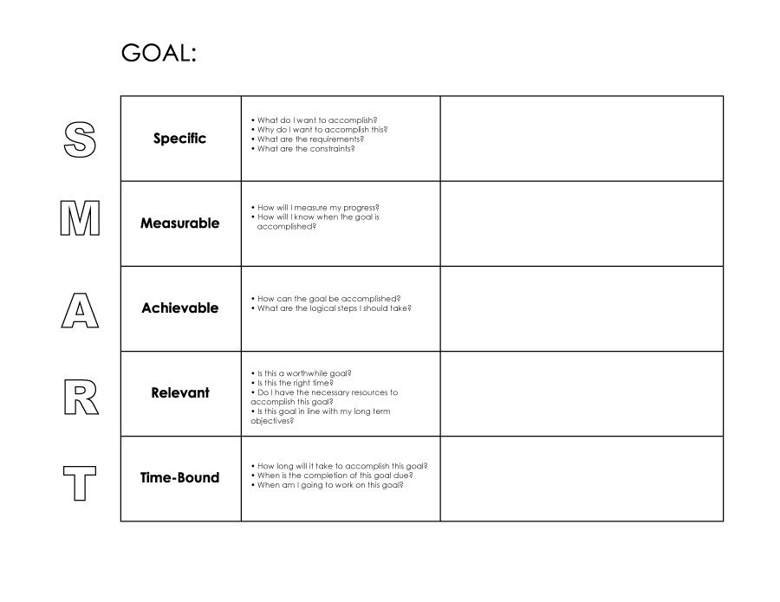
A Personal SMART Goal
Lets take a few minutes to think of a SMART Goal for this week…
  This can be based on anything that’s happening in your life at the minute e.g. work, studies, self-care etc.

Slide 14

The main body
Start Here!
The main body is series of paragraphs
Remember: 1 point = 1 paragraph

Slide 15
Defining your plan
Use your reference groups to plan your paragraphs (i.e. plan to put similar or different references in the same paragraph)
  Is the argument similar or different to other arguments I have read? (group similar/different arguments using mind maps, post-its etc.)
Decide what order you want to put the paragraphs in.
Get writing!

Slide 16
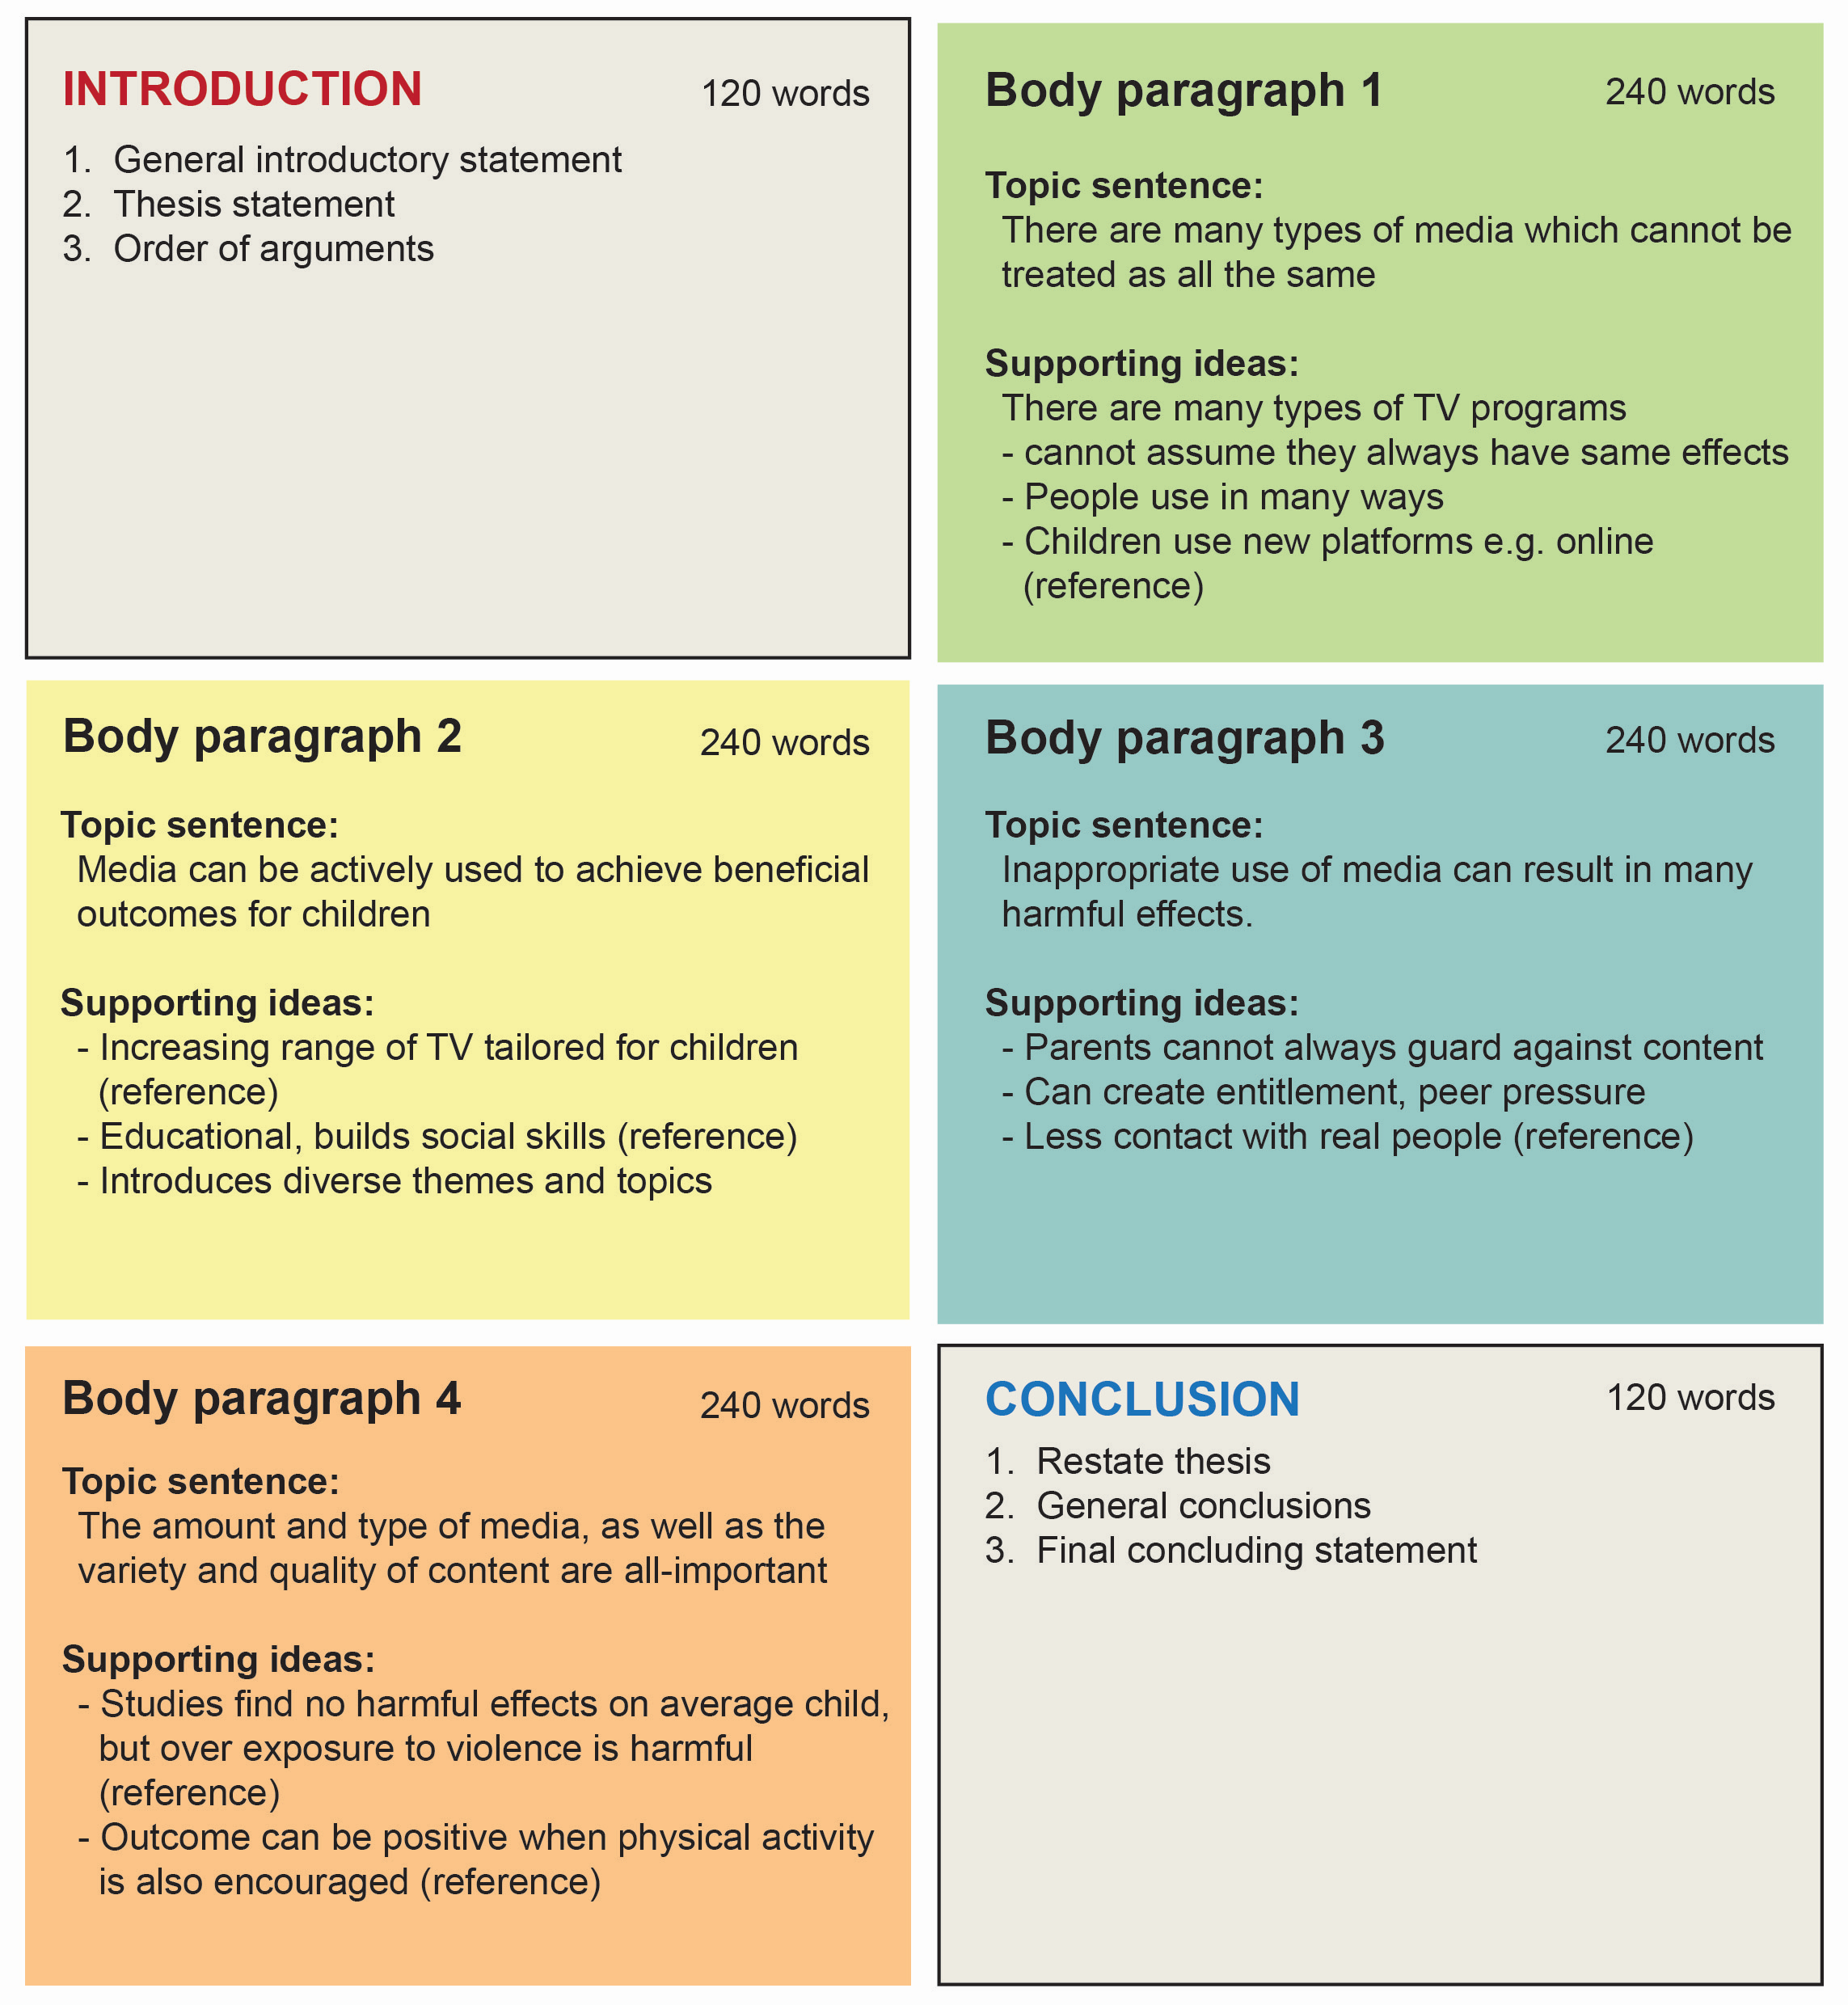

Slide 17

Paragraph Structure
Paragraphs are groups of sentences
What groups them? One idea!
Each paragraph
  Introduce
  Backup with evidence
  Summarise
  Make sure each paragraph is unified around a single main idea.
  Make sure that all of the arguments or examples in the main body of the essay support or explain your thesis statement.
Notes:
An example of a simple way to structure a paragraph or section could be as follows:
Obviously this is not a rigid structure but I’m providing it as a starting point for those of you that might get stuck.
Select a central point for the paragraph
Explain it
Give sources for and against
X writer said this, Y writer said this
Give your opinion and a reason for it to tie it together
Find a way to link to the next paragraph (e.g. find a word or concept common to the last line and first line of next paragraph (Donelan, 2014)

Slide 18
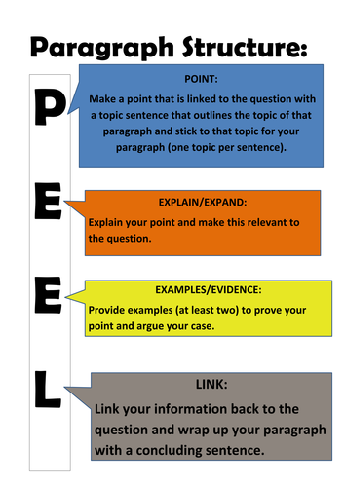
Paragraph structure

Slide 19
Building an Argument
Claim + Supporting evidence+ argument indicators + conclusion= Argument
Example:
  Claim: Students with poor attendance fail more exams…
  Supporting Evidence: …as can be seen in university statistics.
  Argument Indicator: As a result, it can be concluded that…
  Conclusion: …attendance is a factor in achieving good results.

Slide 20
Verbs or “bolts”
Verbs are the bolts that you will use to hold your argument together. They are usually used in the present tense e.g. Bruner (1986) claims….
Examples of Verbs;
  Advocates
  Argues
  Agrees
  Claims
  Emphasizes
  Indicates
  Highlights
  Expands
  Proposes
  Warns
  Suggests
  Recommends
  Reports
  Confirms

Slide 21

Argument indicators as ‘Signposts’
Argument indicators act like signposts pointing towards an argument you are making e.g. Running on icy surfaces is dangerous, so it is important to proceed cautiously.
Examples;
  Since
  Because
  For
  Thus
  Therefore
  It follows that
  As a result, it can be concluded that
  This would suggest that
  If…then…

Slide 22

Can you spot what is wrong with this paragraph??

Slide 23
Why Introduce and Conclude?
To give your reader an idea of what they are going to read, and, to remind them of what they have read.
Remember, it will be the correctors first time reading your essay so they will appreciate the ‘road signs’ of what your argument is.
You will get more marks!

Slide 24

The Introduction
When your main body is complete
Provide background for your essay topic
State what the essay is about
List what you will talk about
State what side of the argument you are on

Slide 25
Phrases for an Introduction
This report will focus on/examine/give an account of ......
The objectives of this report are to determine whether .....
This report seeks to address the following questions…
The aim of this report is to determine/examine ......
Can also begin with a quote or statement about the assignment or argument.

Slide 26
Example
(DEFINITION) Kelly (2015) defines exam stress as “a state of anxiety surrounding preparation and sitting of university examinations that is more than that which is normally experienced by one’s peers” (Kelly 2015, p. 15). (PURPOSE) This paper will discuss the effects of exam stress on a student population in Dublin. (LIST OF POINTS) Firstly, the negative effects of exam stressed will be outlined. Particular attention will be paid to X and Y theories which state A,B C (REFERENCES). Secondly, theories that support exam stress will be discussed in term of Z theory and X studies (REFERENCES). Finally, D theory will be discussed, which indicates that exam stress can be beneficial in moderation (REFERENCE). (MAIN ARGUMENT) Essentially, this paper will explore evidence against exam stress, evidence supporting exam stress, and, how moderate exam stress may be of benefit to students. Centrally it is contended that moderate stress is beneficial because it increases reasonable study time.

Slide 27

Conclusion
Should mirror your introduction- Remember at 3rd level we are not simply describing research but critically evaluating the information
No new information or concepts should appear in the conclusion
Simply state what you have discussed and add in any personal conclusions or recommendations

Slide 28
Phrases for Conclusions
This report has outlined…
Taking everything into consideration…
As the research has demonstrated, X has been shown to…
Overall, it may be said X can be…
In conclusion, we can say that…
The discussion in this article has given an overview of…

Slide 29
Tips to stay focused
Talk your paper. Tell a friend what your paper is about. Pay attention to your explanation. Are all of the ideas you describe actually in the paper? Where did you start in explaining your ideas. Does your paper match your description? Can the listener easily find all of the ideas you mention in your description?
Ask someone to read your paper out loud to you. Ask a friend to read your draft out loud to you. What do you hear? Where does your reader stumble? Sound confused? Have questions? Did your reader ever get lost in your text? Did ideas flow in the order the reader expected them to? Was anything missing for the reader? Did the reader need more information at any point?

Slide 30
Making your essay look good
Basic Layout
Line between each paragraph
  Use margins at the sides and top and bottom of the page e.g. 3cm at sides & 2.5 cm at the top and bottom
Use italics, bold and underline appropriately e.g. headings
Use Images and pictures that are relevant and assist understanding (Avoid clipart)
Line Spacing (1.5 or Double)

Slide 31

Key Points to Remember
Stay calm & set SMART goals
Stay focused and follow your plan
Stick to your word count
Proof read your draft out loud (ask a peer)
Remove (“I”, “We”)
Re-draft/re-read/repeat
Remember!
Check that you have referenced your material- use your essay plan to remind you
Spell check your work before printing

Slide 32
Book an appointment
List the free times in your timetable & send to:
  Email: learningdevelopment@iadt.ie
  Phone: 01 239 4790 or 0871023215
For example: My free times this week are; Mon, 9-11am and 12-1pm and Tues, 11am-1pm.

