Slide 1

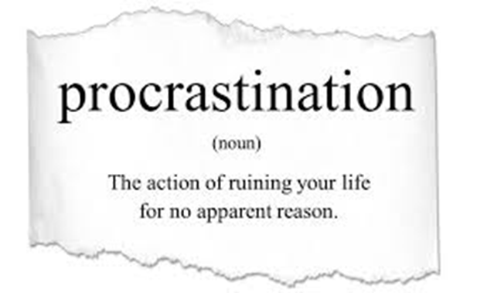
Avoid Procrastinating
Study Smart Workshop
Student Learning centre

Slide 2
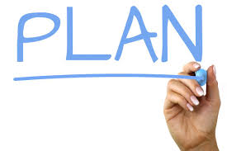
Welcome & thank you for coming
Objectives for this workshop;
  What is procrastination
  How to avoid it?
  Benefits of avoiding procrastination

Slide 3

Let’s take a minute before we begin…
Name 5 things you can see
Name 4 things you can feel/touch
Name 3 things you can hear
Name 2 things you can smell or taste (or like to smell and taste)
Take 1 Deep Breath

Slide 4
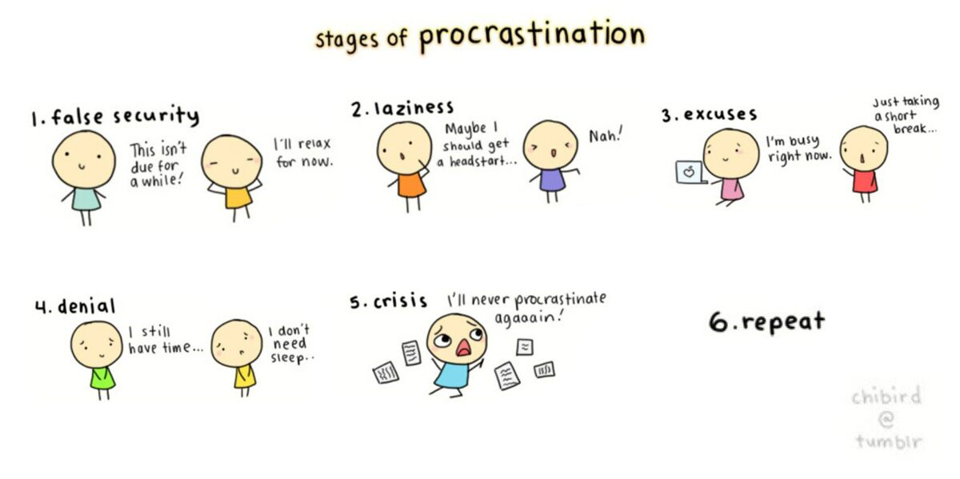
This might sound familiar…

Slide 5
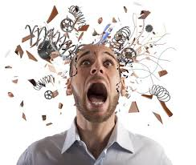
We are all guilty!
We can all be guilty of procrastinating- we can all think of countless times we procrastinated!
Procrastination can have adverse affects on your schoolwork and overall happiness.
We know what we should be doing but we just don’t do it.
It’s easy to put off dreaded activities- Instant short-term relief.
The problem with giving in to this short-term thinking is that it is highly likely that you will be faced with yet another all-nighter before a deadline, potentially in tears and very stressed trying to submit an assignment that doesn’t showcase your best work!

Slide 6

Ten Tips to Avoid Procrastinating
1. Get organized & Get started
2. Set simple, achievable goals
3. Stop making excuses
4. Set a deadline
5. Get rid of distractions
6. Time yourself
7. Take a break
8. Use incentives
9. Get the hard stuff done first
10. Tell someone about your goal

Slide 7

1. Get Organised & Get Started
It is very difficult starting assignments if you don’t know where to start.
Invest in a wall planner (or use the calender on your phone), a diary and/or a notebook to record important notes.
Being organised helps you keep track of all your assignments and helps you feel more on top of things.
  If you feel overwhelmed the things we have to do repeat over and over in our minds. Write them down on paper to help settle your mind. If your assignment isn’t due for a while make sure to write a start date in your calendar or diary.
  Get started; Don’t overthink it, just start writing even if you know you will change it (that’s what drafts are for).

Slide 8
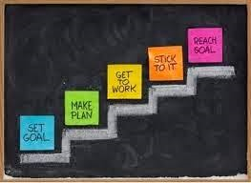
2. Set Simple, Achievable Goals
Feeling overwhelmed about daunting tasks is typically one of the main factors of procrastination- Don’t blow them out of proportion!
The best thing you can do to stay positive is to not think about the magnitude of the assignment and break it down.
It’s always easier to get started on a project when you establish simple, reachable goals rather than a big, vague plan.
  "I'll study biology tonight,” is better planned as "I'll study chapter six tonight."
  This makes your goals less intimidating and more attainable.

Slide 9
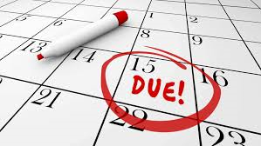
2. Set, simple, Achievable Goals
We often say things like;
  Some day I will get around to organising x, y, z
  One day over the next few weeks I will do x,y,z
  In next semester, I will…
Instead we need to set a specific goal to work towards.
Set yourself personal deadlines to complete work- Just because the lecture gives you a deadline doesn’t mean you can’t get it done in advance, especially if you have events coming up around the same time.
  E.g. set yourself a deadline of 2 days in advance of the deadline then you have some extra time if anything comes up.

Slide 10
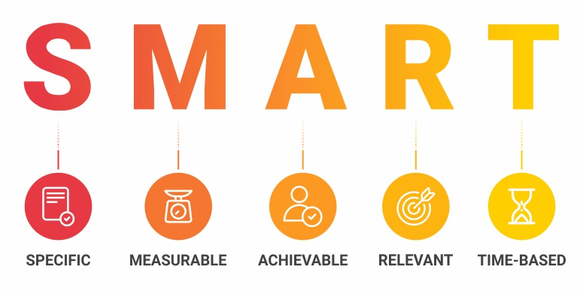
SET Smart goals

Slide 11
Example of a SMART Goal
S: Begin introduction
M: I will write 200 words
A: I can manage 200 words
R: Working towards deadline
T: Tonight 6-9pm

Slide 12
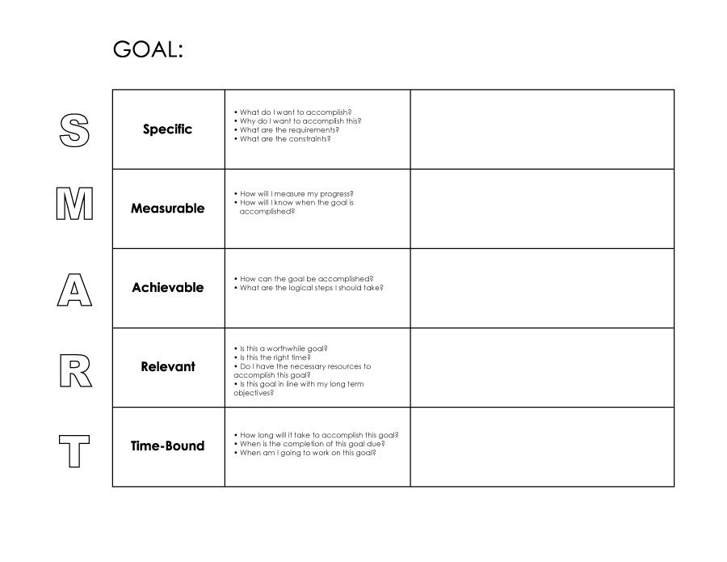
A Personal SMART Goal
Lets take a few minutes to think of a SMART Goal for this week…
  This can be based on anything that’s happening in your life at the minute e.g. work, studies, self-care etc.

Slide 13

3. Stop Making Excuses
We are all guilty of waiting for that perfect time to start something.
We continuously make excuses as to why we haven’t got something done or even started.
The problem is that we will continue to make these excuses until we make a conscious effort not to!
Examples;
  “I would love to get that in ahead of schedule but it’s not possible because I’m so busy”
  “If I didn’t have X going on, I would be fine”
  “ I will wait to hear what others are doing before I start”
  “I haven’t got all my research done yet so I will wait”
Life Happens and there will be many times we have to prioritize our health and well-being over studies but we can prioritize both simultaneously
  Stop waiting for the perfect moment- it doesn’t exist

Slide 14

4. Create a Timeline/Schedule
Once you have identified your goals, create a timeline to achieve them.
  This could include a study plan, the breakdown of an essay etc.
  Remember you must be specific!
  Don’t forget to include some time for rest and fun.
It’s important you stick to your timeline;
  Things will inevitably come up but don’t beat yourself up, instead take a breath, remind yourself that life happens and get straight back on track.

Slide 15

5. Minimize Distractions
We often get needlessly sidetracked from our work.
If you tend to spend too much time on social media or apps when you should be studying, then shut your phone off (all the way off) or keep it out of sight e.g. in your bag etc.
Distractions could also be external sources, like people talking, typing etc. Try listening to relaxing music or white noise to cancel out the noise.
You might need to change your study environments all together;
  This could be the library or a quiet coffee shop, where you can clear your mind and study distraction-free.

Slide 16
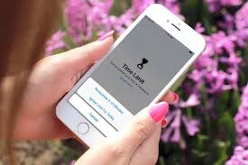
6. Set Time Limits
Set-time limits for both study and fun or relaxing activities.
If you stick to time limits you can enjoy your breaks guilt-free (just don’t forget to go back to studying!)
E.g. I will study for 2hrs with no distractions and then can watch my favourite programme for 1 hr.
This might all seem too rigid and like too much effort but take a moment to think of all the time you wasted procrastinating and stressing and the nicer ways you could have spent that time.

Slide 17
7. Take a Break
It is so important to take breaks from your studies otherwise you will burn out.
Take short regular breaks throughout the day;
  54321 exercise is good to help you take a quick 5 minutes out and re-focus
Studying and/or working doesn’t mean you have to give up all the things you love. You can still play sports and enjoy hobbies- we just need to manage our time more effectively.
If you are stressed and over-whelmed the best thing you can do is to take a break-go for walk, talk to someone, close your eyes for a few minutes, whatever works for you.

Slide 18

8. Use Incentives
We all need to be rewarded!!
Long-term goals can be difficult to work towards as they feel so far away.
It’s important to find what motivates you to get things done in advance rather than leaving things to the last minute.
Give yourself an incentive for reaching a goal e.g. if I get my assignment finished before I leave college today, when I go home I can binge watch Netflix all evening.

Slide 19
9. Get the Hard Stuff done first
It is very tempting to start the easier jobs and get distracted by easier jobs that are not as important.
Instead, identify the most challenging aspects of your assignments and start with them.
  The longer you put it off, the more formidable it will seem.
This way everything after it seems easier and takes a shorter amount of time.

Slide 20

10. Tell Someone about your Goal
Seek the help of others to keep you accountable!
Tell a friend, partner or family about your plan and update them on your progress. Tell them why it’s important you stick to your deadline/time limit and they can support you with this.
As an added bonus, you also have someone to celebrate your victories with, no matter how small.
Use each other as supports- link it with classmates to hold each other accountable.

Slide 21

Conclusions
Start making changes today to avoid the inevitable stress that comes along with procrastination.
Choose 2-3 things that you think will be most helpful and put them into action TODAY.
  You will thank yourself when it comes to your next deadline

Slide 22
Booking an appointment
List the free times in your timetable & send to:
  Email: learningdevelopment@iadt.ie
  Phone: 01 239 4790
For example: My free times this week are; Mon, 9-11am and 12-1pm and Tues, 11am-1pm.

